Slide 1
From CIAM to TeamX,
Structuralism, and Metabolism
Contemporary Architecture Theory
Eugene Han
Fall 2020, 11:15 – 12:30 pm
Online Instruction
Notes:
This section is really about the aftermath of Modernism, and the knee-jerk reaction against it.

Slide 2
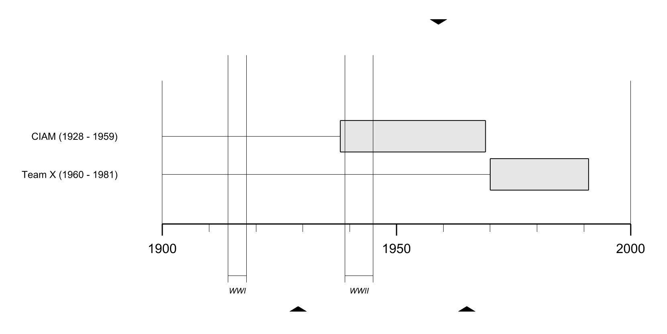

Slide 3
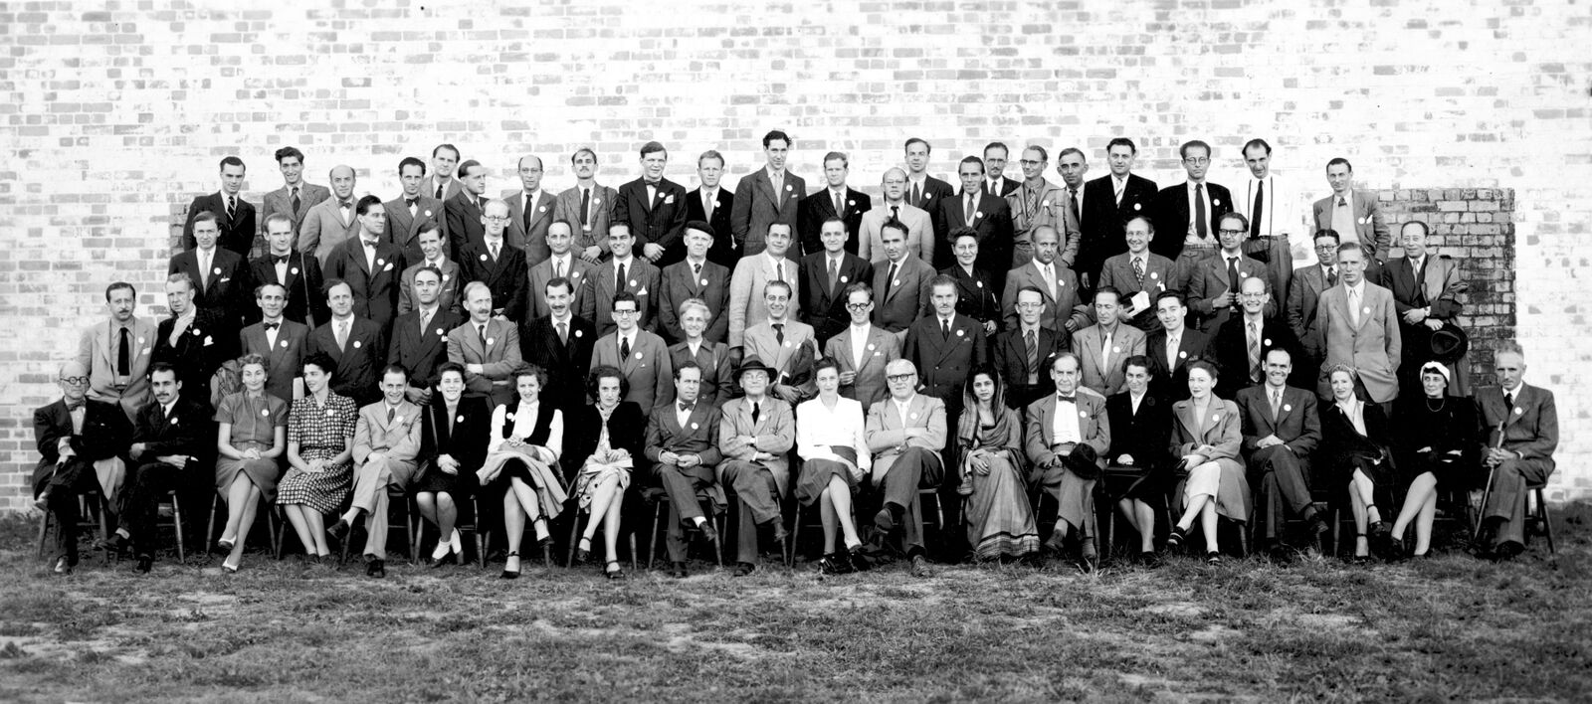
CIAM
Congrès internationaux d’architecture moderne
1928 - 1960
Notes:
We begin a group called CIAM: Congres internationaux d’architecture modern (Congress of international modern architecture)
Especially towards inception, chief language was French, namely because Le Corbusier was one of its founding members
Walter Gropius was also a member, and Mies even made an appearance.

Slide 4
CIAM I – La Sarraz, Switzerland
1928: Foundational Meeting
CIAM II – Frankfurt am Main, Germany
1929: The Minimum Dwelling
CIAM III – Brussels, Belgium
1930: Rational Land Development
CIAM IV – Athens, Greece
1933: The Functional City
CIAM V – Paris, France
1937: Dwelling and Recovery
CIAM VI – Bridgwater, England
1947: Reaffirmation of the aims of CIAM
CIAM VII – Bergamo, Italy
1949: The Athens Charter in Practice
CIAM VIII – Hoddesdon, England
1951: The Heart of the City
CIAM IX – Aix-en-Provence, France
1953: Habitat
CIAM X – Dubrovnik, Yugoslavia
1956: Habitat
CIAM XI – Otterlo, The Netherlands
1959: Dissolution of CIAM, Commencement of Team X
Notes:
We begin a group called CIAM: Congres internationaux d’architecture modern (Congress of international modern architecture)
Especially towards inception, chief language was French, namely because Le Corbusier was one of its founding members
Walter Gropius was also a member, and Mies even made an appearance.

Slide 5
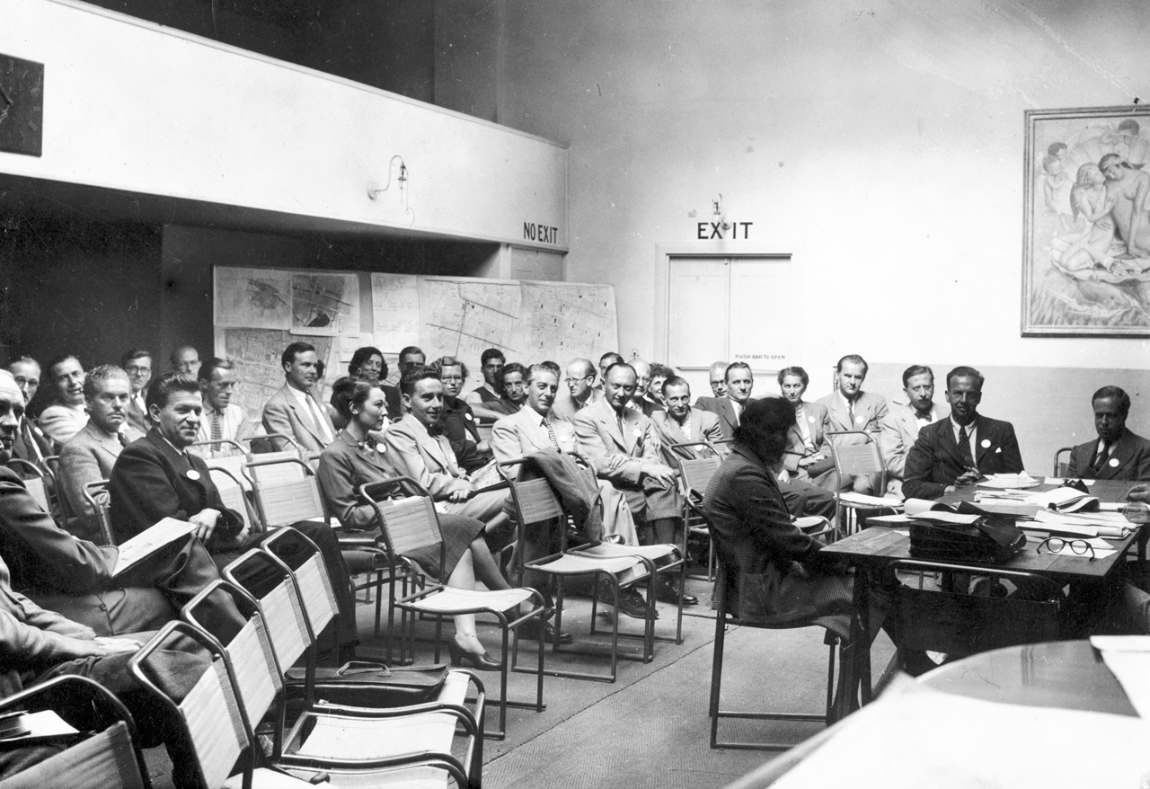
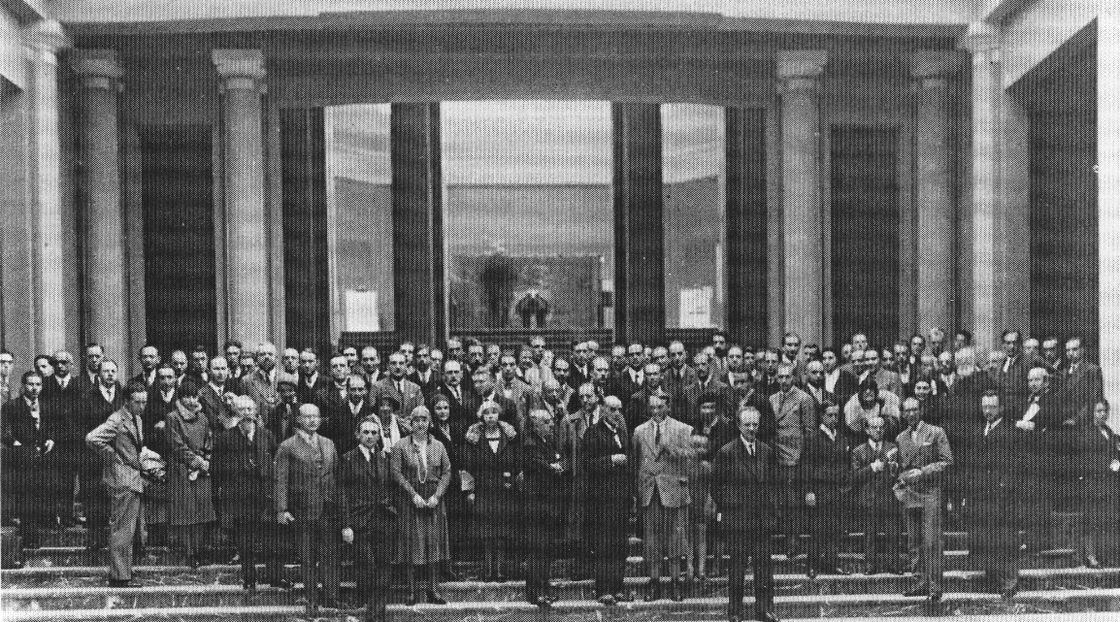
Left: CIAM 6 – Bridgwater, England (1947)
Right: CIAM 3 – Brussels, Belgium (1930)
Notes:
CIAM was an organization, a club, founded in 1928 by 24 architects – after 11 meetings, they disbanded in 1959.
Corbusier was undoubtedly its most prominent members – many argue that CIAM was created to essentially perpetuate Corbusian ideals.
The group served as a kind of advisory board to institutionalize and standardize Modernist theory into practice.
Founded in La Sarraz, Switzerland
Principal edict claimed that architecture and design could no longer be considered in isolation to the way countries were governed and run
Social and economic conditions were an integral component to urban design, and therefore must be considered by architects
In conjunction to this, building and construction technologies could facilitate this higher level of integration

Slide 6
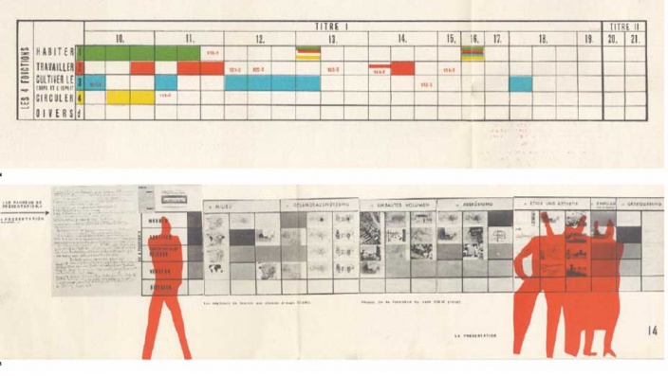
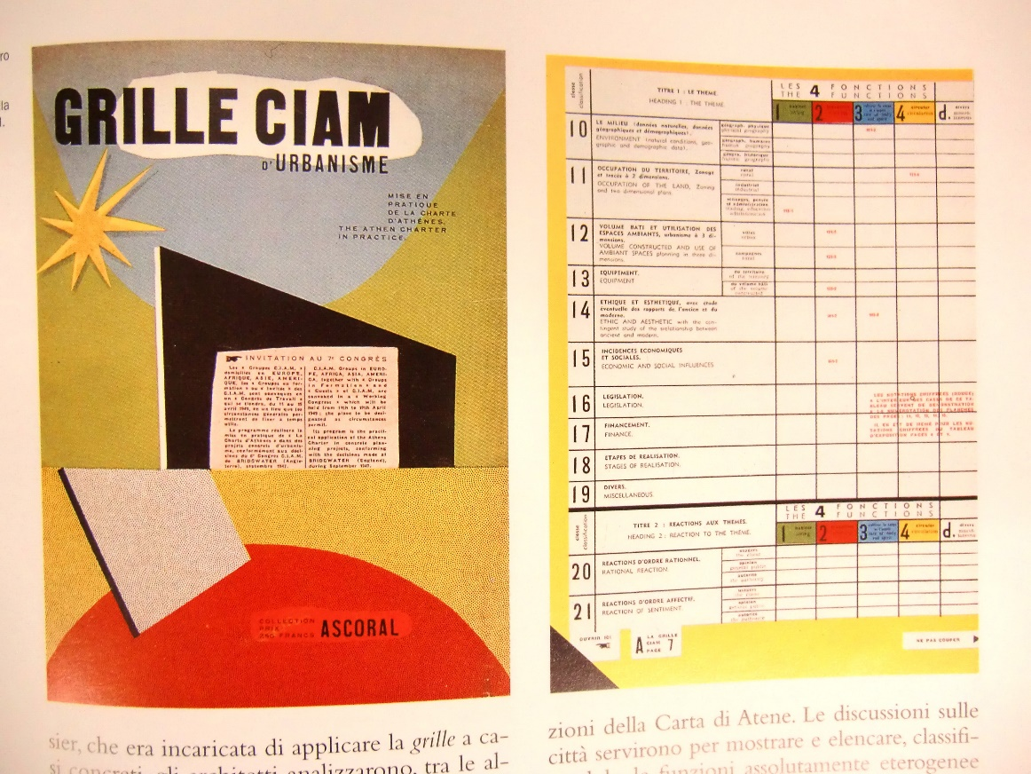
Proposal for a ‘Grille CIAM’ (CIAM grid) for presentations
Notes:
The format for their meetings was highly structured:
They would collectively decide the ‘topic’ for each session, and a select group of them, the most prominent, would pin up boards and discuss and debate the merits of Modernist strategies.
This format is in large part responsible for the format of many studio course crits that we have today.
It’s not that CIAM invented it, but it was certainly an early example of how architects share their ideas – their version of ‘peer review’
The presentation structure was simple: each presenter would have a grid, a ‘grille’, and they would address various scales and functions of architecture and the city according to a certain design ideal.

Slide 7
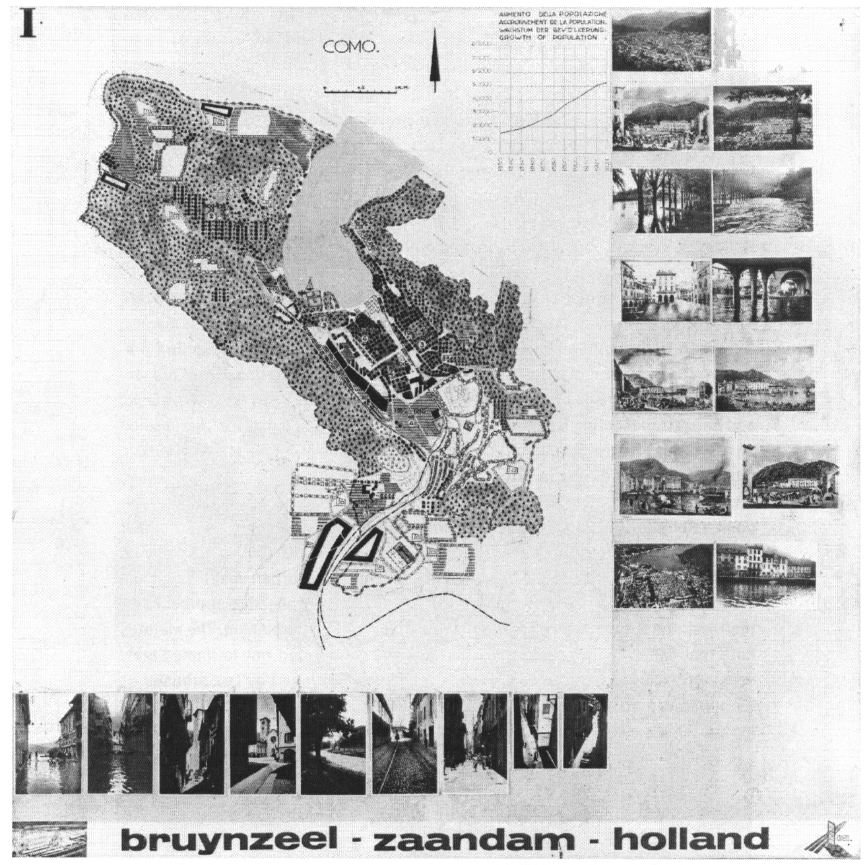
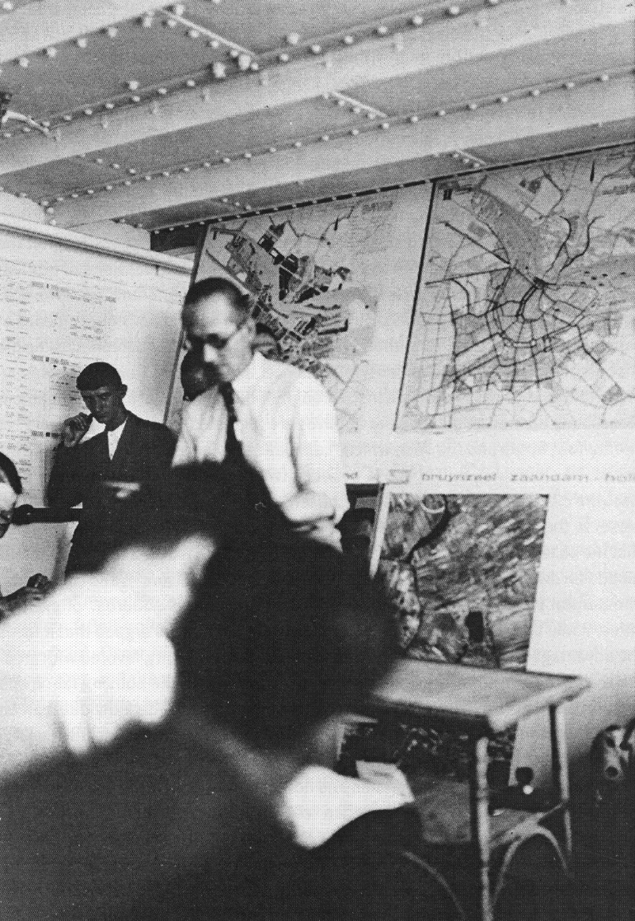
Left: Le Corbusier presenting his ideas, CIAM 4 (1933)
Right: Guiseppe Terragni’s analytical plan of Como (Italy) for CIAM 4 (1933)
Notes:
Here’s Corbusier presenting his ideas on city development and planning at CIAM 4.

Slide 8
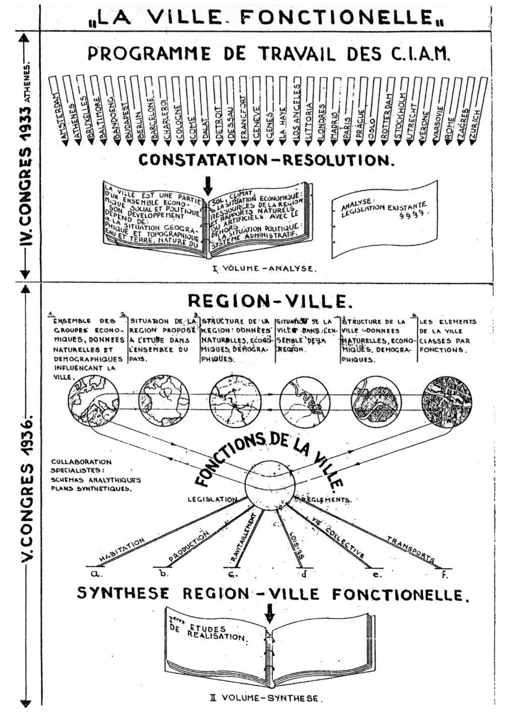
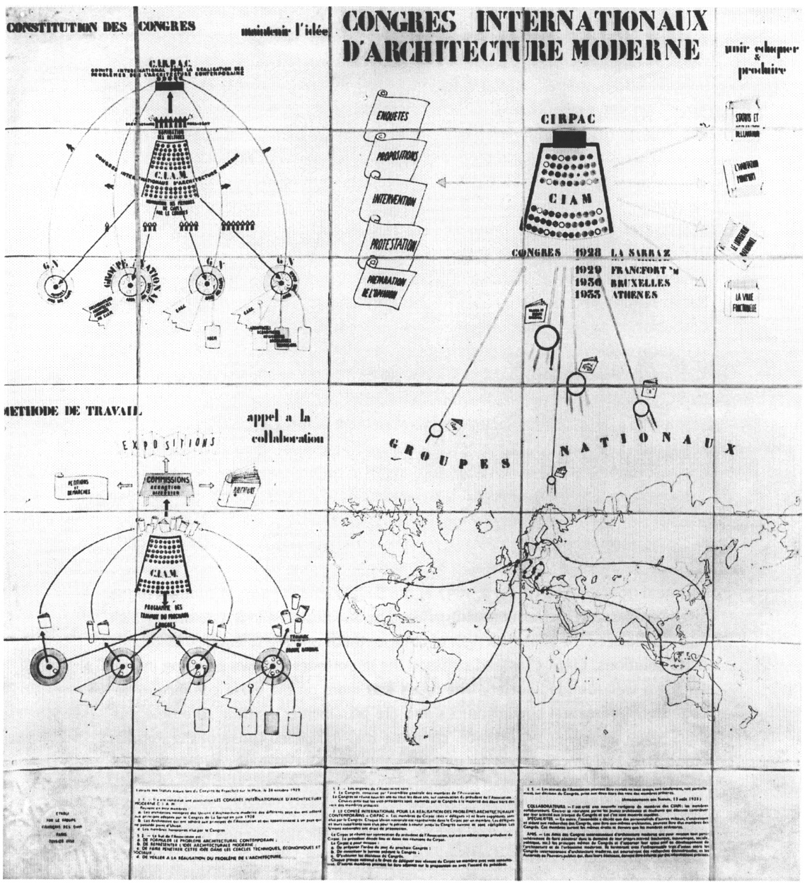
Proposal for organizational structure, CIAM 4 (1936)
Notes:
Even though it hadn’t been founded yet, you could say they were kind of like a United Nations (1945) of modern architecture and urbanism.
They certainly saw themselves like this, and had quite a complex internal system of organization that was decidedly international – that was the point of Modernism

Slide 9
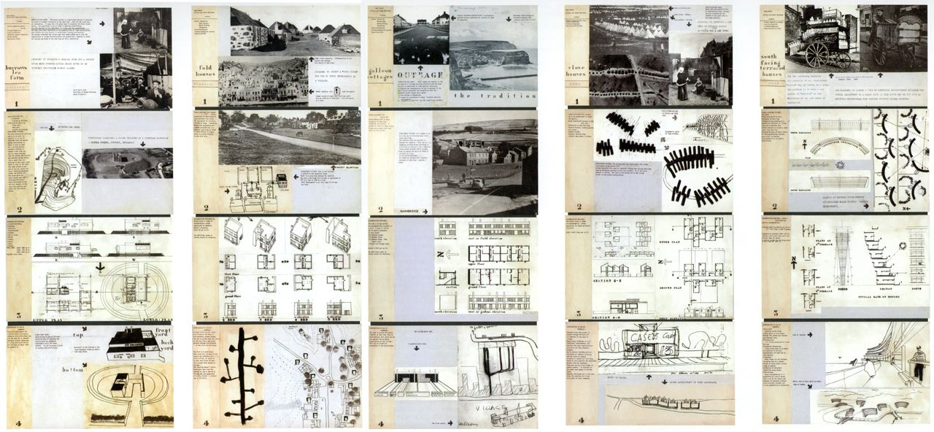
Display board for CIAM 10, Dubrovnik (1956)
Notes:
Principal topics of scale for CIAM
Building
Landscape
Urbanism
Industrial design
Its self-imposed mandate was to find ways to improve the world through design
Disassociation with the past to produce cities as ‘solutions’
That was the Modernist goal – highly scientific
Identify the problem
Come up with a solution

Slide 10
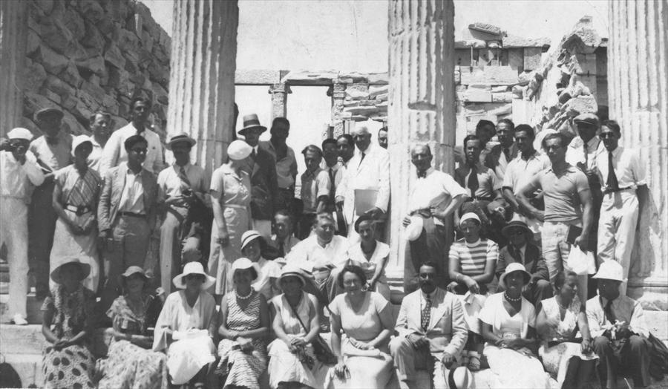
Group photo – CIAM 4, Marseilles, France to Athens, Greece (1933)
Notes:
4th meeting of CIAM (1933 – ship from Marseilles to Athens) produced the Athens Charter, as written by Corbusier in 1943.
Typified the organization’s ambitions and approach (‘Modernist’)
Functionalist turn in urban planning
Strict separation of housing, working, recreation, and traffic
Monofunctional zones – zoning
Shouldn’t discuss like there was unanimous consensus on issues such as the Athens Charter, however CIAM and its decrees became emblematic of Modernism’s aspirations
An unconditional faith that with the right design model, the ideal city and architecture form could be engineered
Believed its domain to be universal, that is, for both the West and East, and southern hemisphere, regardless of culture and demographical differences

Slide 11
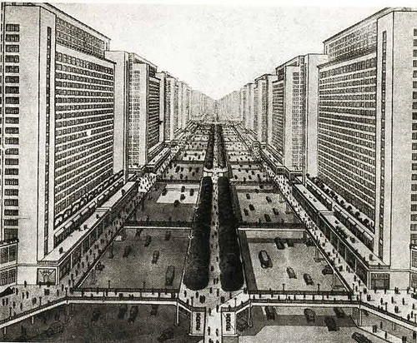
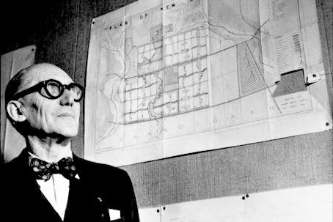
Corbusier, Ville Radieuse
Notes:
As the years progressed, it was becoming clear that subgroups were forming, and that wholesale ‘charters’ on architecture were becoming removed from the reality of the city
Also by the 50s, the range of participation was fizzling out
By the last few summits, a clear schism was beginning to form between older and younger members of CIAM, particularly as the British and Dutch groups were separating from the French groups

Slide 12
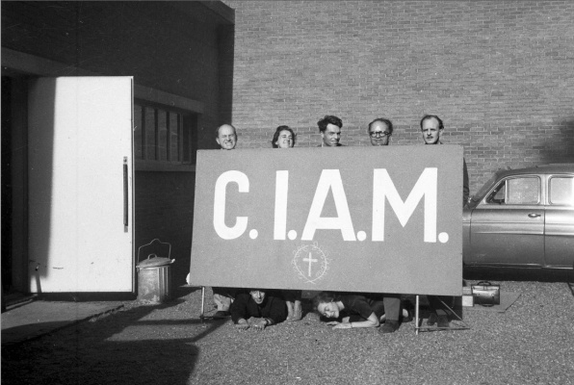
The death of CIAM, Otterlo (1959)
Alison and Peter Smithson, John Voelcker, Jaap Bakema, Sandy van Ginkel – Aldo van Eyck, Blanche Lemco
Notes:
Team X was formed in 1954 (just after CIAM 9, Aix-en-Provence), as an independent subgroup of CIAM

Slide 13
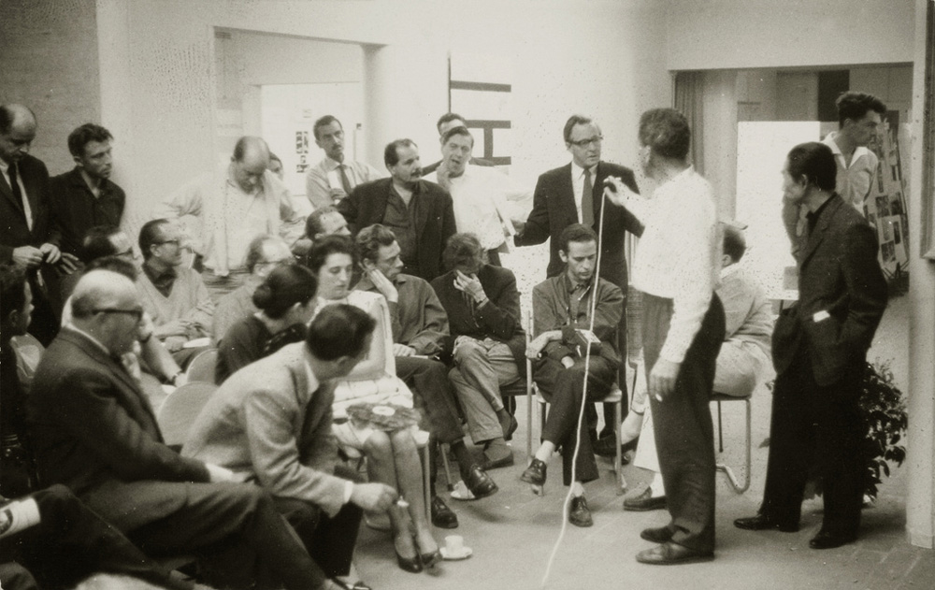
Team X
1953 - onwards
Notes:
The Smithsons (British) formed a group with other younger CIAM members, most notably including Aldo van Eyck, and Jaap Bakema (both Dutch)
While practicing individually, as a group, they were perhaps more defined by what they were not (not CIAM), rather than what they were
Heavily representing the Netherlands and Britain
It now becomes more obvious why CIAM began as heavily Franco-centric to Anglo-Centric
Anglo: British and Dutch influences

Slide 14
Team X (at CIAM) - Otterlo
1959
Bagnols-sur-Cèze, France
1960
Royaumont, France
1962
Berlin, Germany
1965
Urbino, Italy
1966
Toulouse, France
1971
Berlin, Germany
1973
Rotterdam, The Netherlands
1972
London, UK
1975
Spoleto, Italy
1976
Bonnieux, France
1977
Team X meetings, (1959* - 1977)
Notes:
Kind of like CIAM, their work was based on discourse, over the course of a series of meetings.
However, as you’ll see in the reader, their planning was far more informal, and likened themselves to a small extended family than a large international group.
Likewise, their meetings weren’t prescribed according to set topics, but the topics emerged organically.

Slide 15
Team X
Modernism
Freedom
Simultaneity
Integration
Town-planning
Structure
Function of Architecture
Dictatorship
Hierarchy
Chaos
Administration
Decoration
Functionalism
Notes:
An attempt to identify universals in humanity, but recognize that each culture may have their own way of doing things
Here’s a comparison of ethos between Team X and CIAM
You can see that their approach was really dependent on bottom-up organization, rather than top-down prescription.

Slide 16
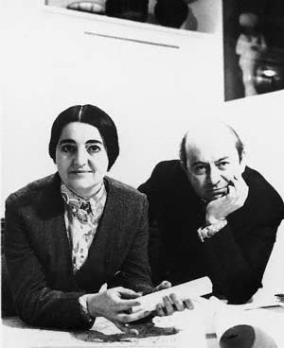
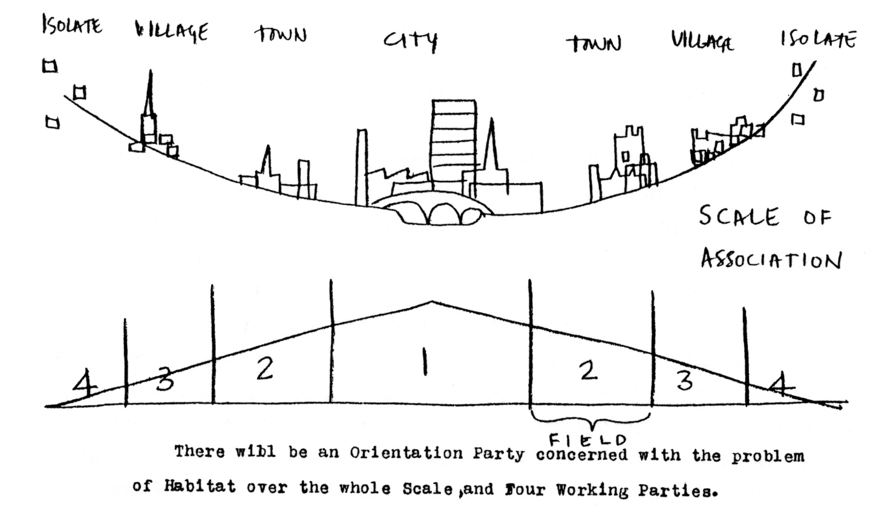
Alison Smithson, The Emergence of Team X out of CIAM: Documents (1982)
Notes:
Among the most vocal of the Team X members were the architect couple Alison and Peter Smithson from the UK.
And we can see how different this latter generation was in their theory of ‘Scale of Association’, which essentially stated that there was no one optimal form of living, but that different conditions ‘naturally’ produced a variety of dwelling clusters.
In other words, housing in a village naturally clusters differently than those in a city – this was incredibly different than what Corbusier was espousing with his Ville Radieuse, which was nothing short of a universal solution for everyone, everywhere, and all the time.

Slide 17
“A community should be built up from a hierarchy of associational elements and tries to express these various levels of association (THE HOUSE, THE STREET, THE DISTRICT, THE CITY) algebraically...
Our hierarchy of associations is woven into a modulated continuum representing the true complexity of human association. This conception is in direct opposition to the arbitrary isolation of the so-called communities of the “Unité” and the “neighborhood.””
Alison Smithson, The Emergence of Team X out of CIAM: Documents (1982)
Notes:
Rather than architecture as a single machine type for living, the Smithson’s stated that “A community should be built up…

Slide 18
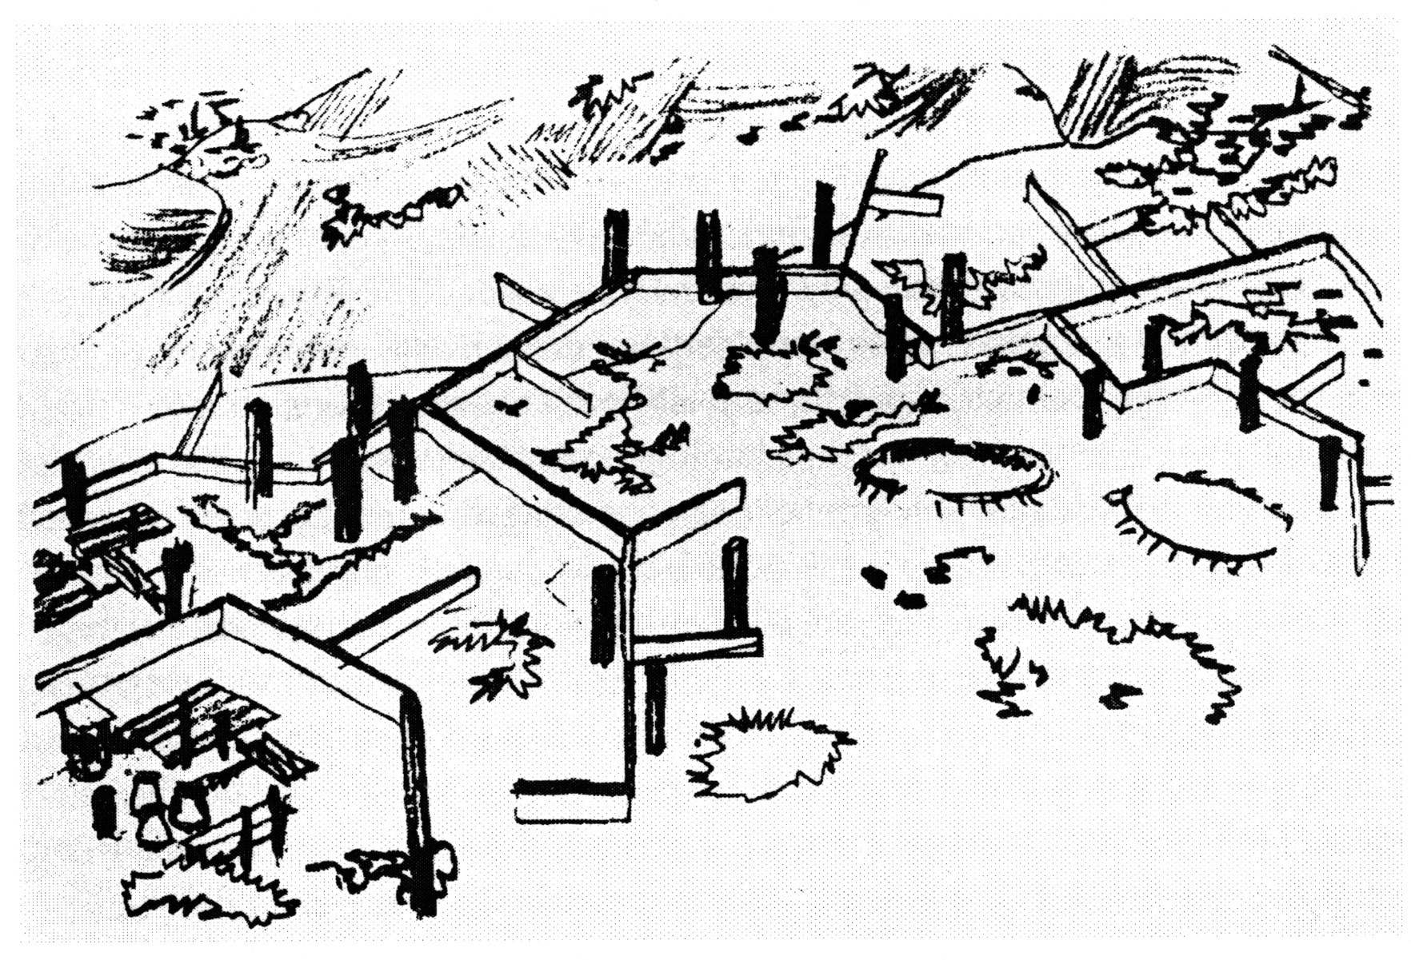
Alison and Peter Smithson, Golden Lane Housing Competition (1952)
Notes:
Here’s an example of their hierarchical organization for the Golden Lane Housing Competition of 1952.
What we see are a combination of towers and streets that organically grow, without center or clearly defined border.
Should not be thought of as a determinate design, but as a kind of prototype, a generative design

Slide 19
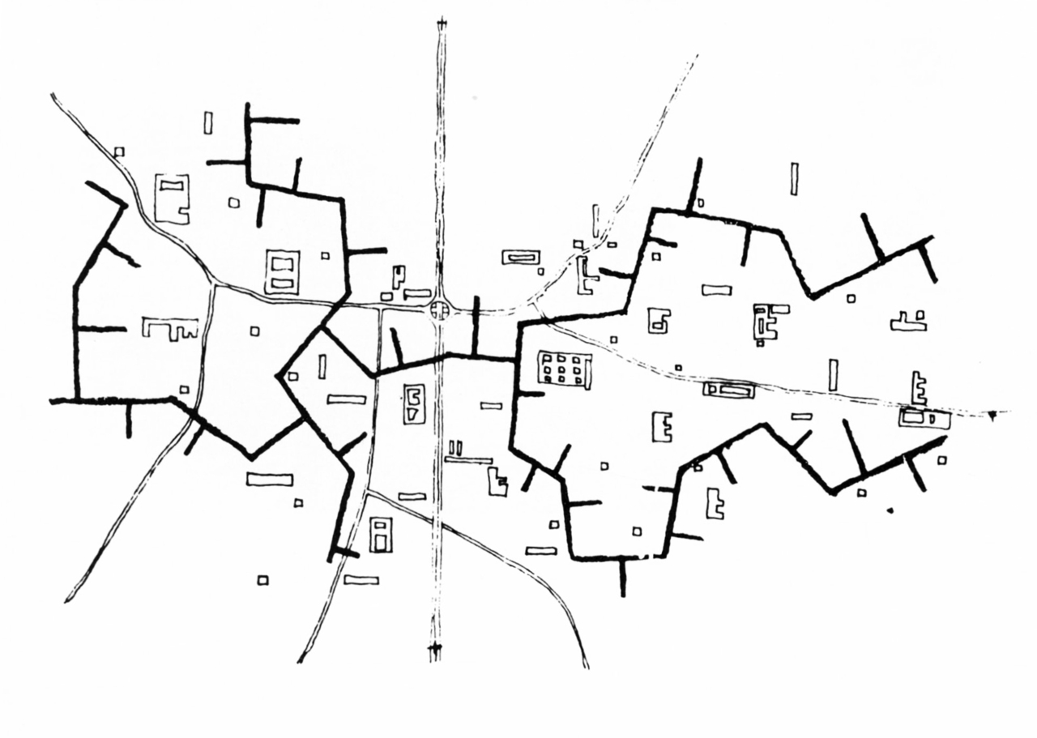
Alison and Peter Smithson, Golden Lane Housing Competition (1952)
Notes:
The language of many of Team X’s works are often described as a kind of molecular geometry, or ‘Genetic’

Slide 20
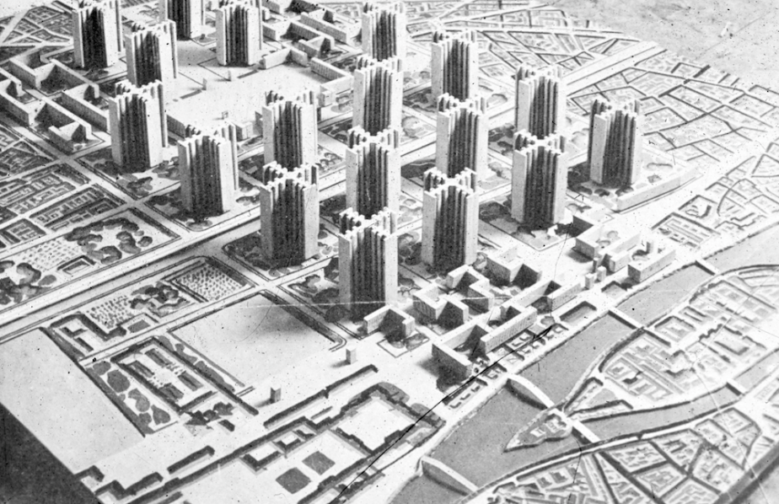
Alison and Peter Smithson, Golden Lane Housing Competition (1952)
Notes:
The ‘urban plan’ was not dictated by an ideal form, but determined by context, including existing structure, topography, site specify
As opposed to many Modernist schemes that necessitated a Tabula Rasa.

Slide 21
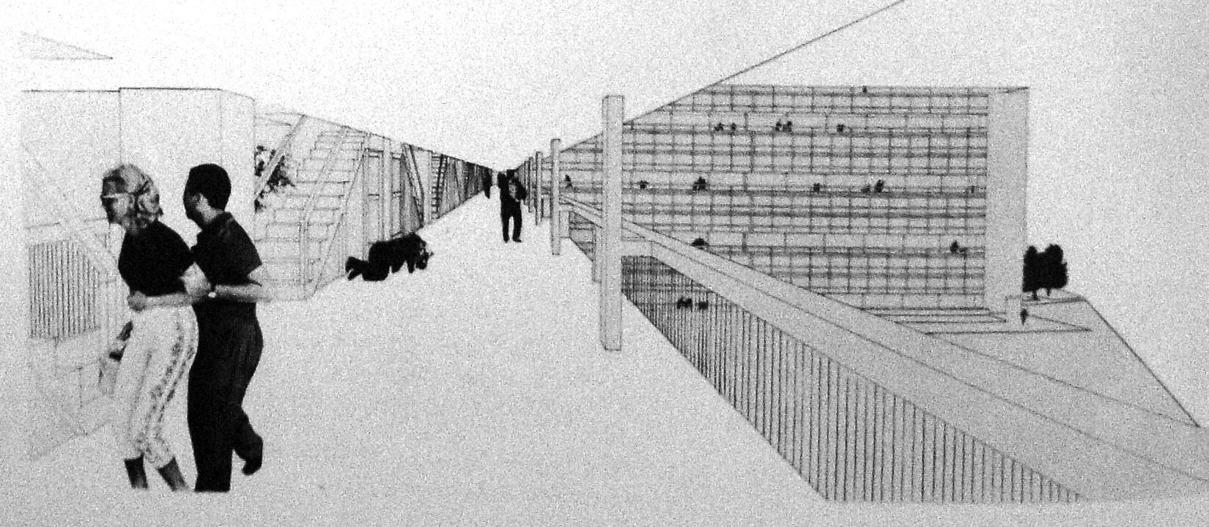
Alison and Peter Smithson, Golden Lane Housing Competition (1952)
Notes:
Here’s an interior rendering of the same project
No height difference between ‘street’ (could be elevated) and the front door
A way of reconfiguring the city, a way of designing its parts anew, without taking away the value/vitality of the working-class street
Good design didn’t necessarily equate to sterile solutions
In fact the ‘gritty’ working class streets may achieve something that idealized models could never do, especially considering that some have proven the test of time

Slide 22
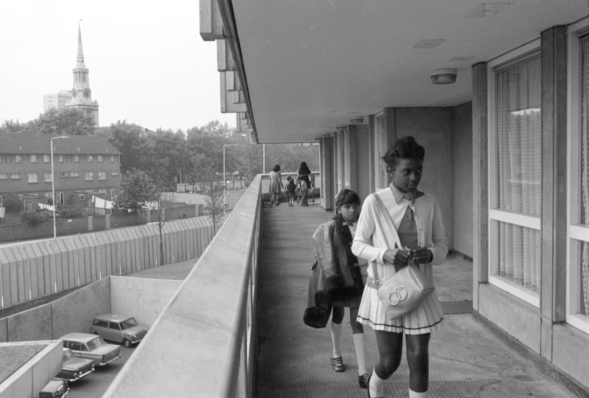
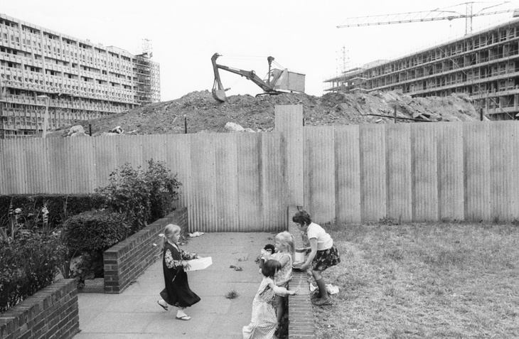
Alison and Peter Smithson, Robin Hood Gardens, London, UK (1972)
Notes:
Here’s a project that was actually built, called Robin Hood Gardens in southeast London
Built in 1972 for working class families, although demolished just this year.
Implementation of their ‘elevated street’

Slide 23
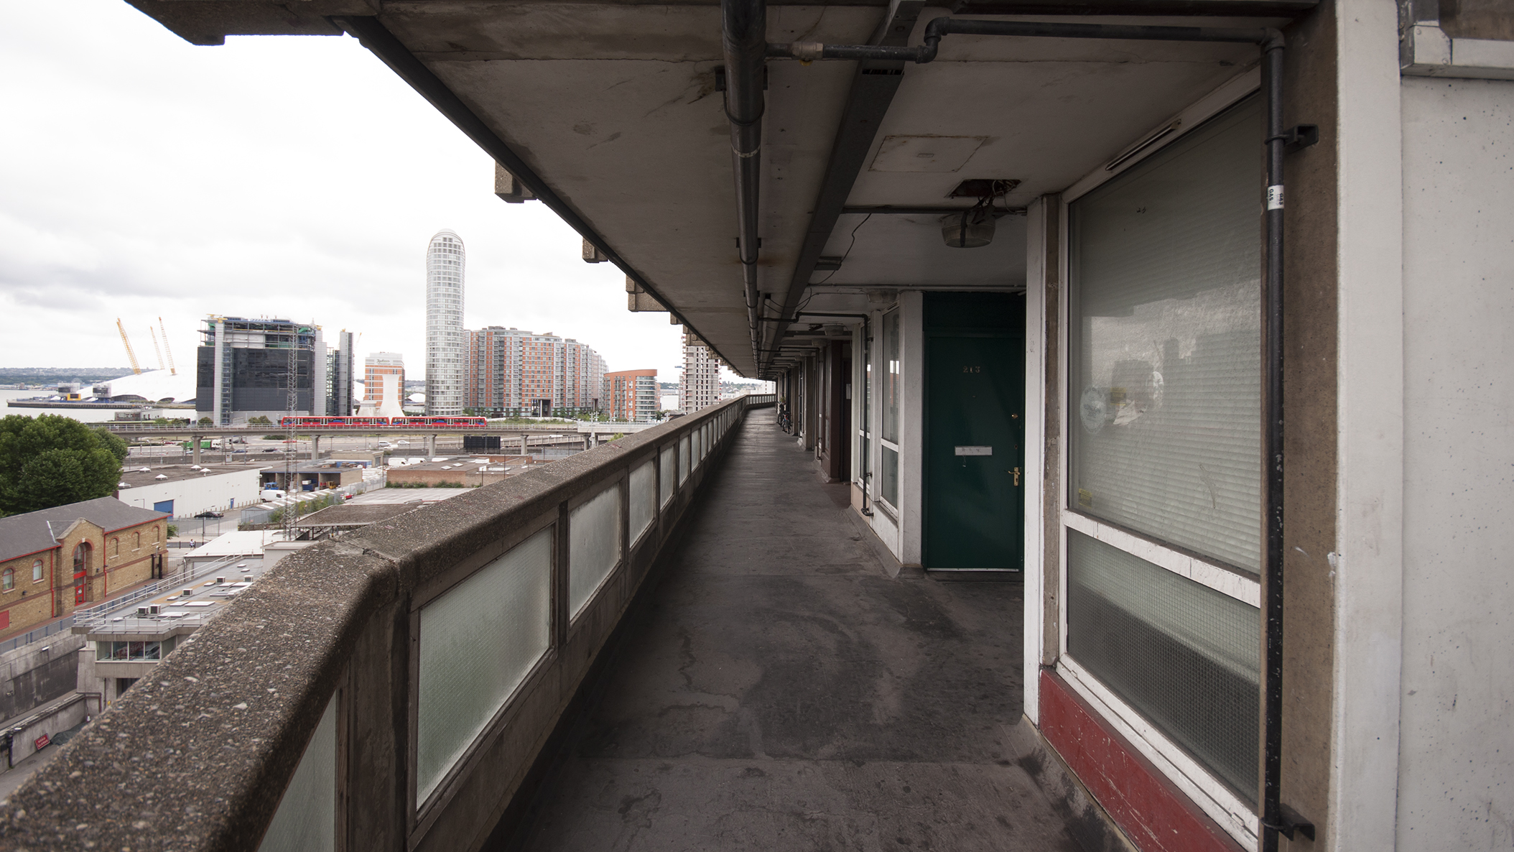
Alison and Peter Smithson, Robin Hood Gardens, London, UK (1972)
Notes:
Here we can see design remnants of the outward facing walkways of their Golden Estate proposal.

Slide 24
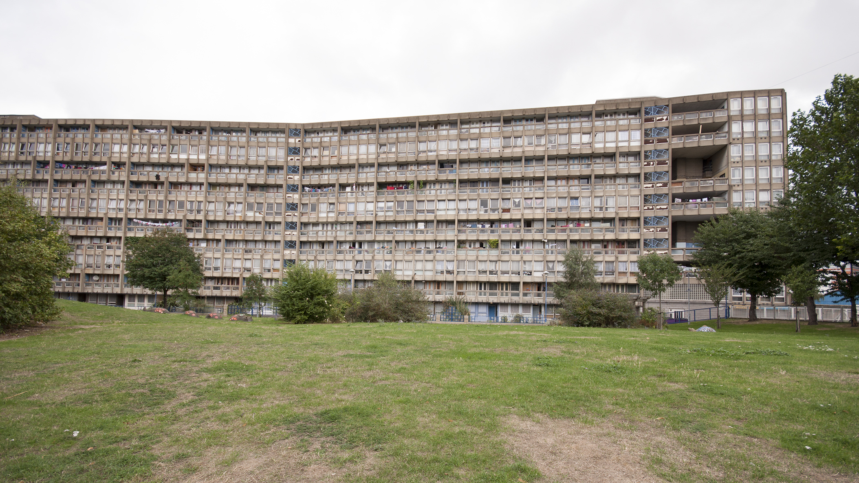
Alison and Peter Smithson, Robin Hood Gardens, London, UK (1972)
Notes:
This kind of ownership of the façade was celebrated by the Smithsons, as it reflected a vitality of the community – a kind of architecture ‘at work’

Slide 25
STRUCTURALISM
Notes:
Before moving on to some examples that grew out of, or along, the Team X movement, it’s critical to acknowledge the movement called Structuralism.
An attempt to show universals in humanity, whilst recognizing perceivable differences

Slide 26
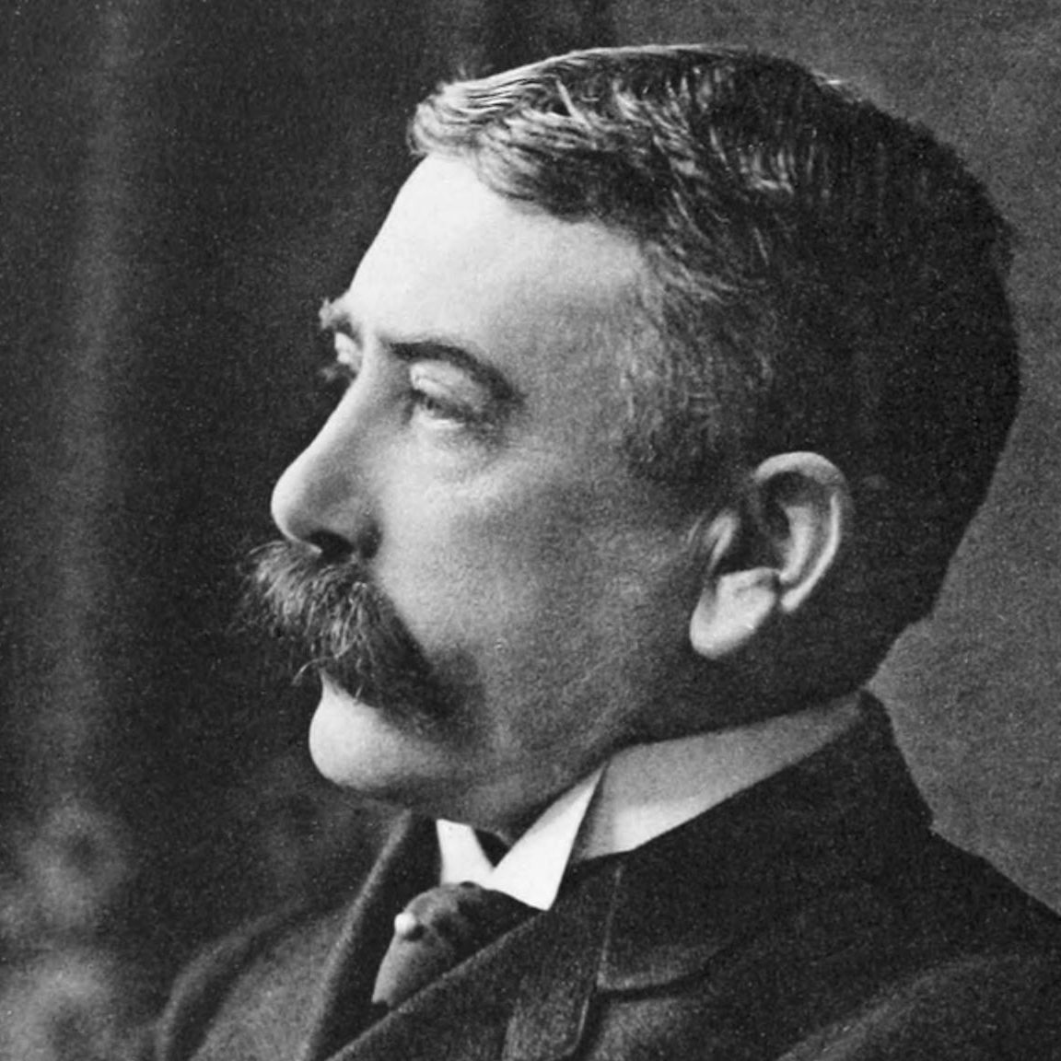
Communication of ideas through language
Ferdinand de Saussure
Swiss, 1857 - 1913
Linguistics
Notes:
His diagram shows that there are two ‘layers’ to communication
The material one made up of sounds
And the meaning ‘underneath’ the sounds

Slide 27
Communication of ideas through language
Notes:
Recognized that the words that we use are arbitrary… no intrinsic link between the word ‘arbor’ (tree) and the concept of tree
A basic concept of tree, that goes beyond any individual tree
A convention of using the word ‘arbor’ to ‘point’ to this basic concept

Slide 28
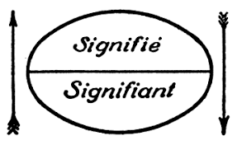
Signe
Dichotomy of the sign
Notes:
Signifier | Signified // Label | Meaning
Signifie – Signified
Signifiant – Signifier

Slide 29
“language is never complete in any single individual, but exists perfectly only in the collectivity”
Saussure, Course in General Linguistics (1916)
Notes:
Critically, language works because it is collective

Slide 30
“language is never complete in any single individual, but exists perfectly only in the collectivity”
Saussure, Course in General Linguistics (1916)
“A community is necessary in order to establish values. Values have no other rationale than usage and general agreement. An individual, acting alone, is incapable of establishing a value.”
Ibid.

Slide 31
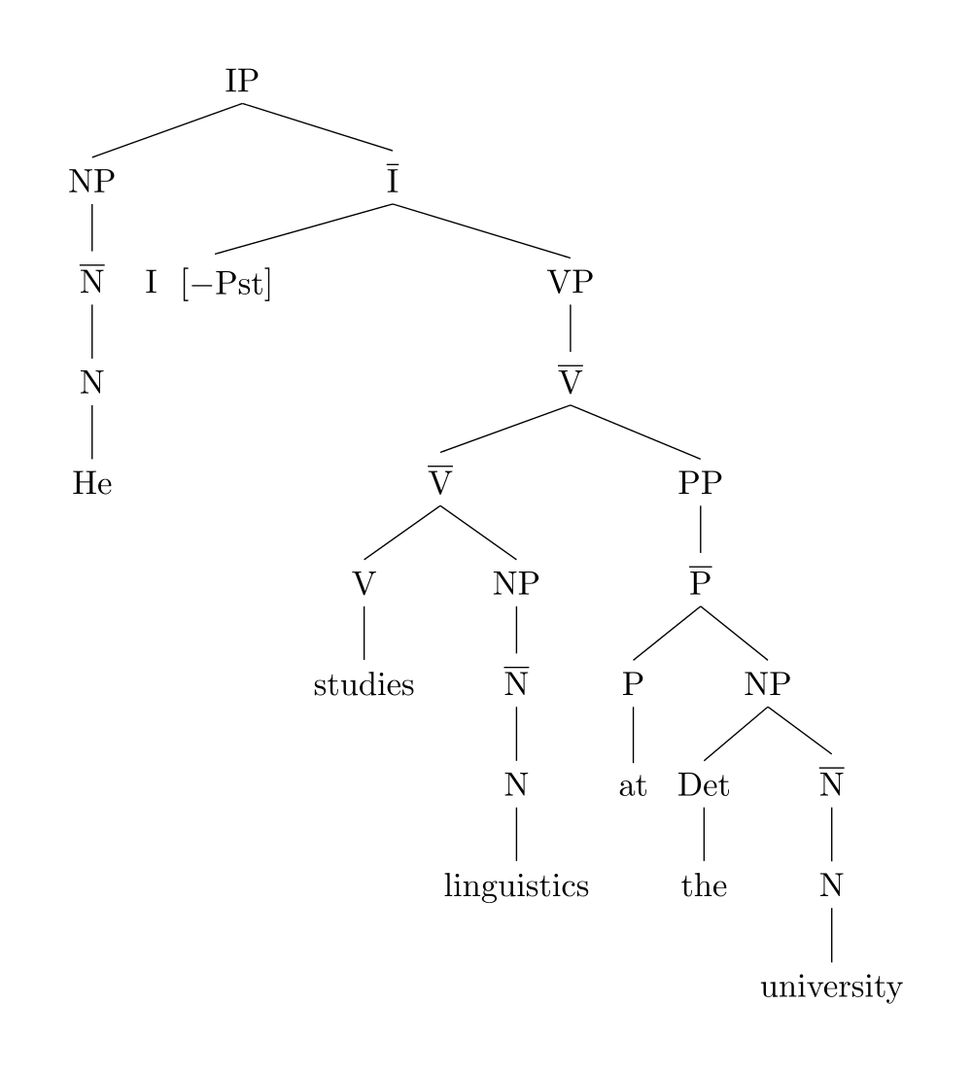
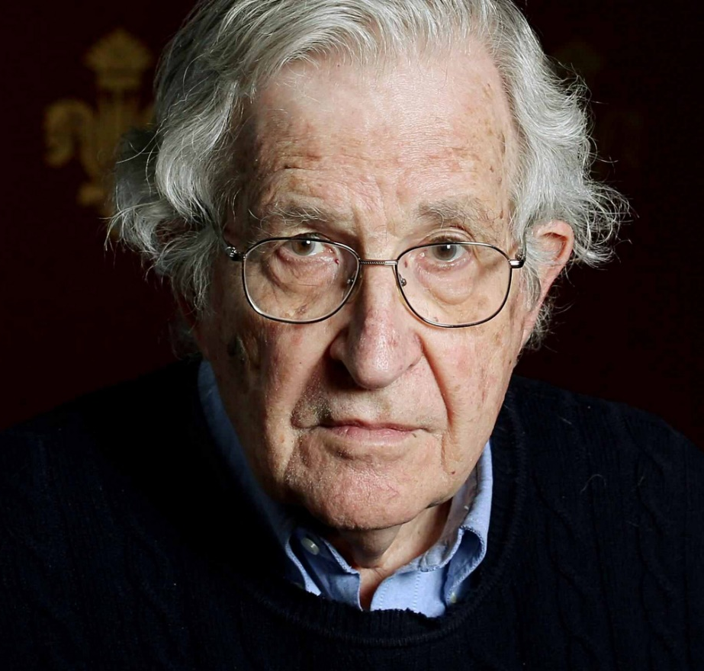
Noam Chomsky
American, 1928 - Current
Linguistics, Politics, Philosophy
Notes:
Noam Chomsky
Didn’t align himself directly within the Structuralist movement, but it’s difficult not to see his linguistics as part of its current
In large part wasn’t grouped into Structuralism as his base was in the US rather than in Europe
Developed a linguistic theory similar to the waves of Saussure, a dichotic system which he called Deep | Surface Structure
In essence, his thesis was that there was a distinction between the composition of the words we use to express a basic idea, and the idea itself

Slide 32
“I ate the apple.”

Slide 33
“I ate the apple.”
“The apple was eaten by me.”

Slide 34
“I ate the apple.”
“The apple was eaten by me.”
“Apple I ate.”

Slide 35
“I ate the apple.”
“The apple was eaten by me.”
“Apple I ate.”
“Comí la manzana.”

Slide 36
“I ate the apple.”
“The apple was eaten by me.”
“Apple I ate.”
“Comí la manzana.”
“나는 사과를 먹었다.”

Slide 37
“I ate the apple.”
“The apple was eaten by me.”
“Apple I ate.”
“Comí la manzana.”
“나는 사과를 먹었다.”
“Я съел яблоко.”

Slide 38
STRUCTURALISM
-
ARCHITECTURE

Slide 39
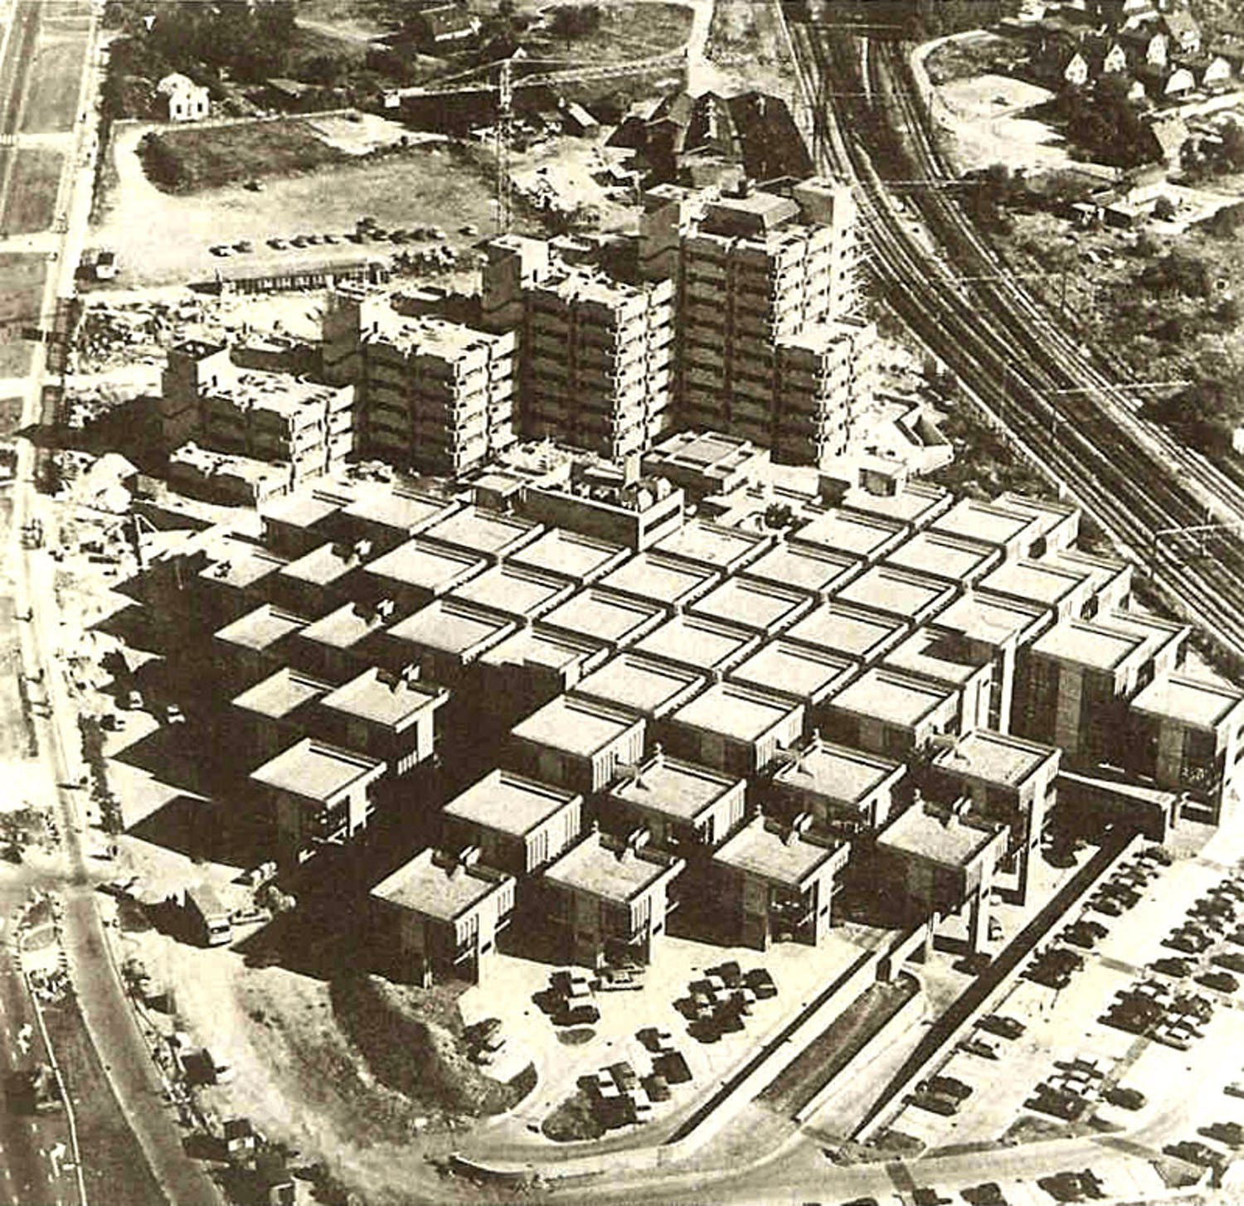
The concepts ‘public’ and ‘private’ may be seen and understood in relative terms as a series of spatial qualities which, differing gradually, refer to accessibility, responsibility, the relation between private property and supervision of specific spatial units.
Herman Hertzberger
Herman Hertzberger, Centraal Beheer Achmea, Apeldoorn, The Netherlands (1972)
Notes:
Used the design of an office complex to understand the range from public to private spaces

Slide 40
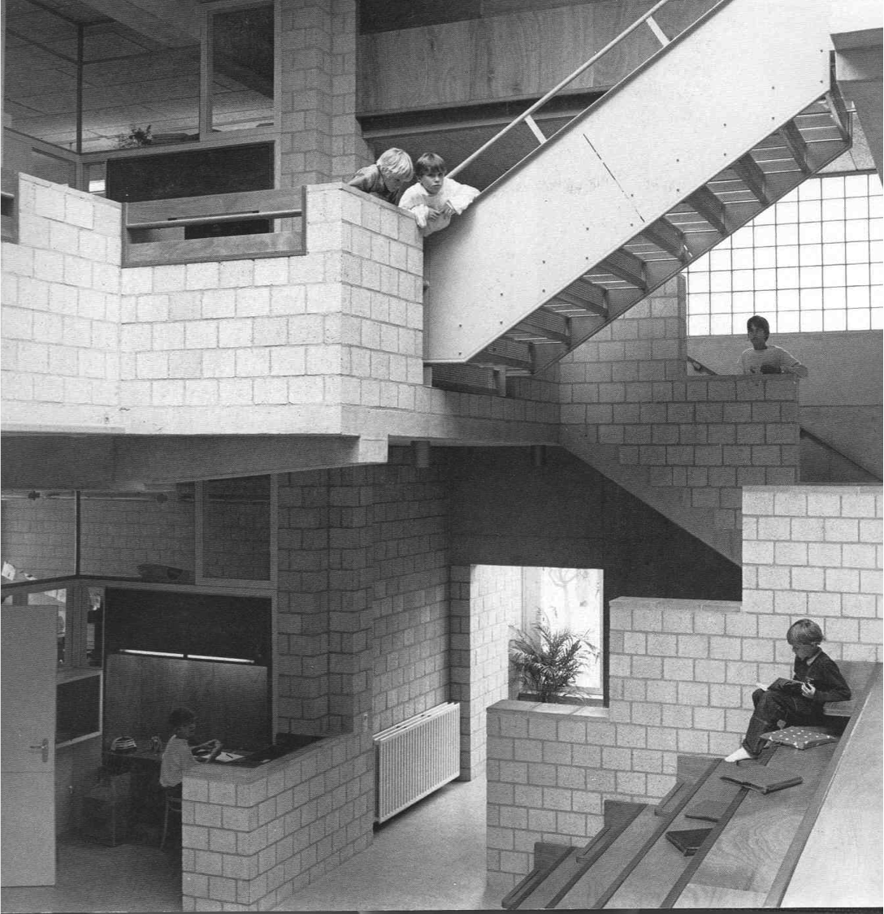
Herman Hertzberger, Centraal Beheer Achmea, Apeldoorn, The Netherlands (1972)
Notes:
Believed that architectural form had an intrinsic and immediate relationship with social orders within the work environment

Slide 41
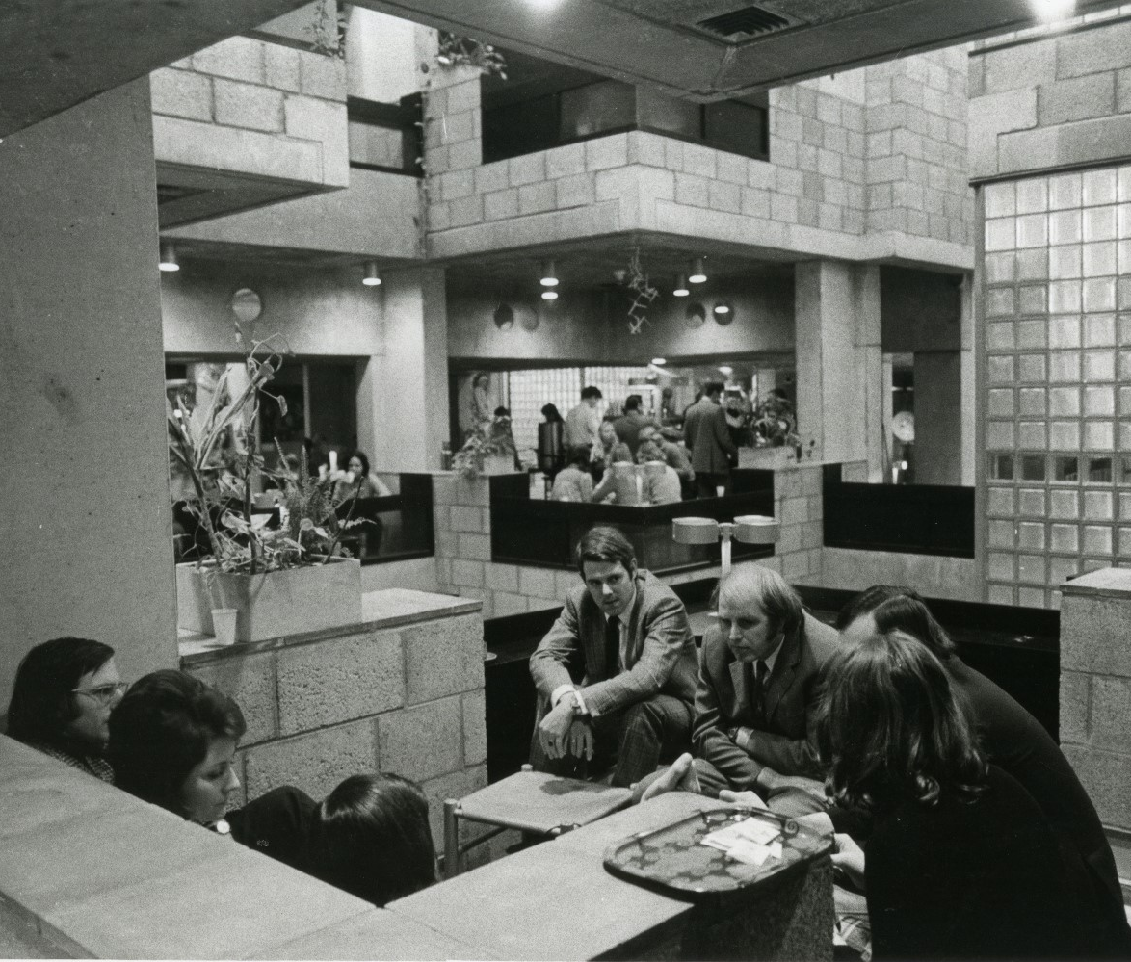
Herman Hertzberger, Centraal Beheer Achmea, Apeldoorn, The Netherlands (1972)
Notes:
Simultaneously private (everyone gets their own pocket of space that they can customize) and public (trays overlooking trays)
The form of the building was such that architecture was used to offer the possibilities of meaningful engagement in the work environment
Not supposed to dictate good space, but enable it

Slide 42
Herman Hertzberger, Centraal Beheer Achmea, Apeldoorn, The Netherlands (1972)
Notes:
- Hertzberger called extent of space “degree of territorial claim”
- He claimed that the building was uniform, but designed in such a way as to discourage conformation (customizing own space), as it was based on the relationships of territories

Slide 43
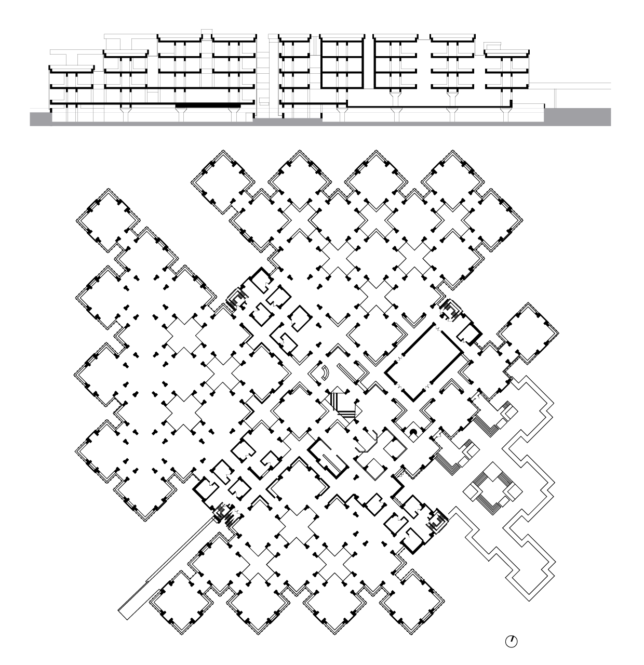
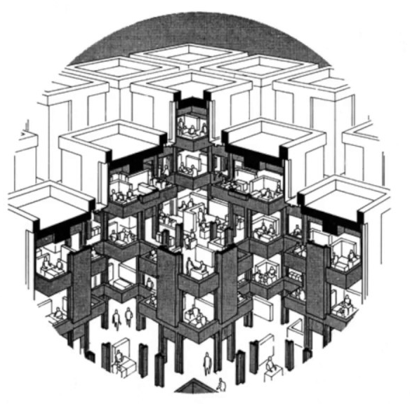
Herman Hertzberger, Centraal Beheer Achmea, Apeldoorn, The Netherlands (1972)
Notes:
- Decentralization of space
- ‘Generative Grammer’ (taken from Chomsky), in which once a basic structure is resolved, can aggregate, along with transformations of the original structure
Self-developing architecture

Slide 44
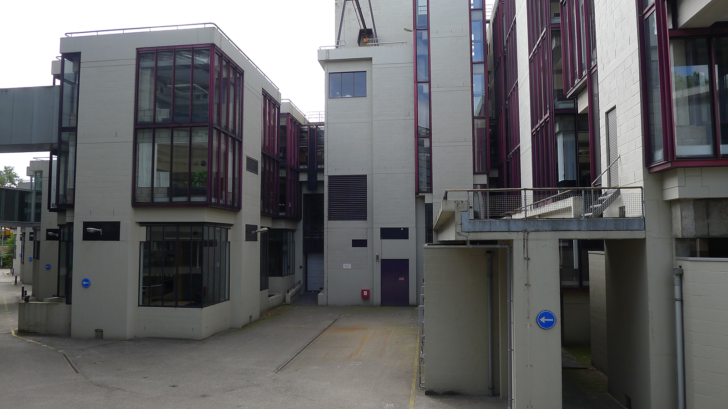
Herman Hertzberger, Centraal Beheer Achmea, Apeldoorn, The Netherlands (1972)

Slide 45
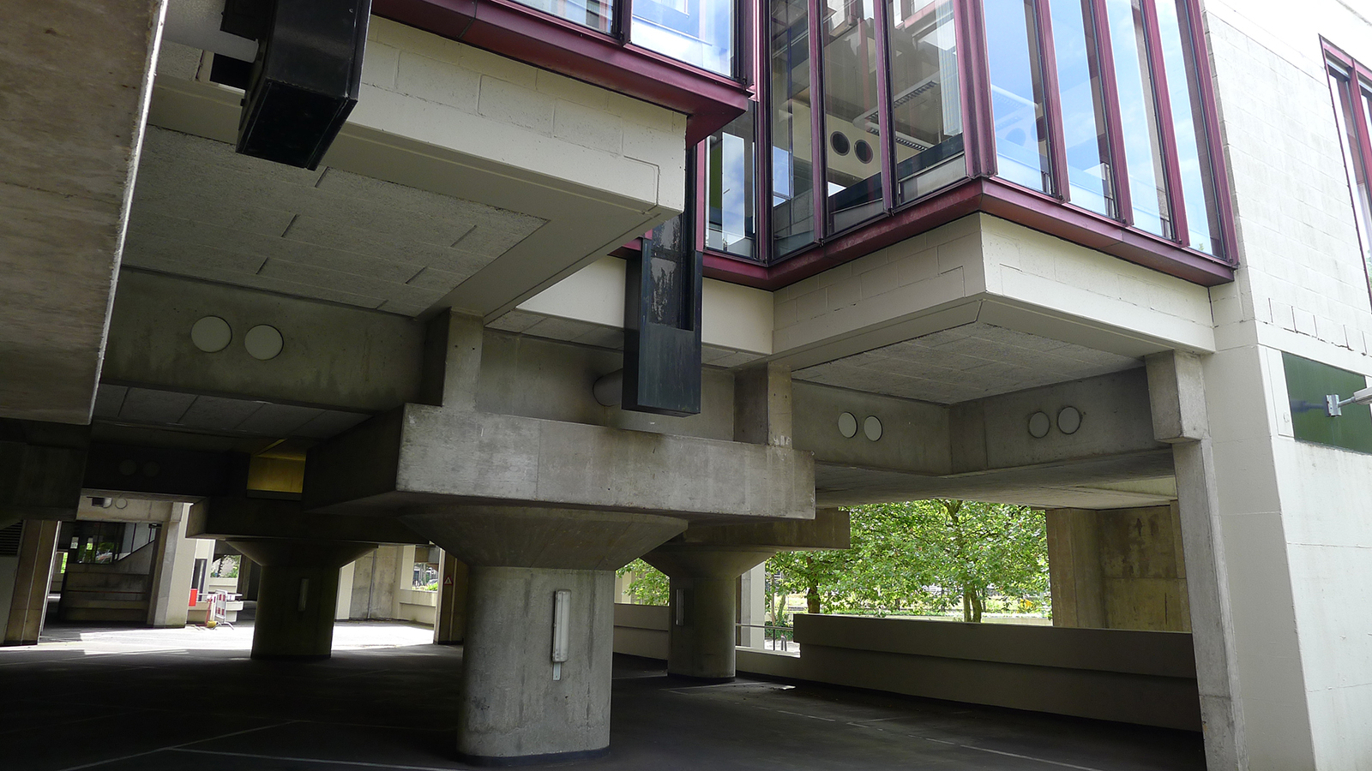
Herman Hertzberger, Centraal Beheer Achmea, Apeldoorn, The Netherlands (1972)

Slide 46
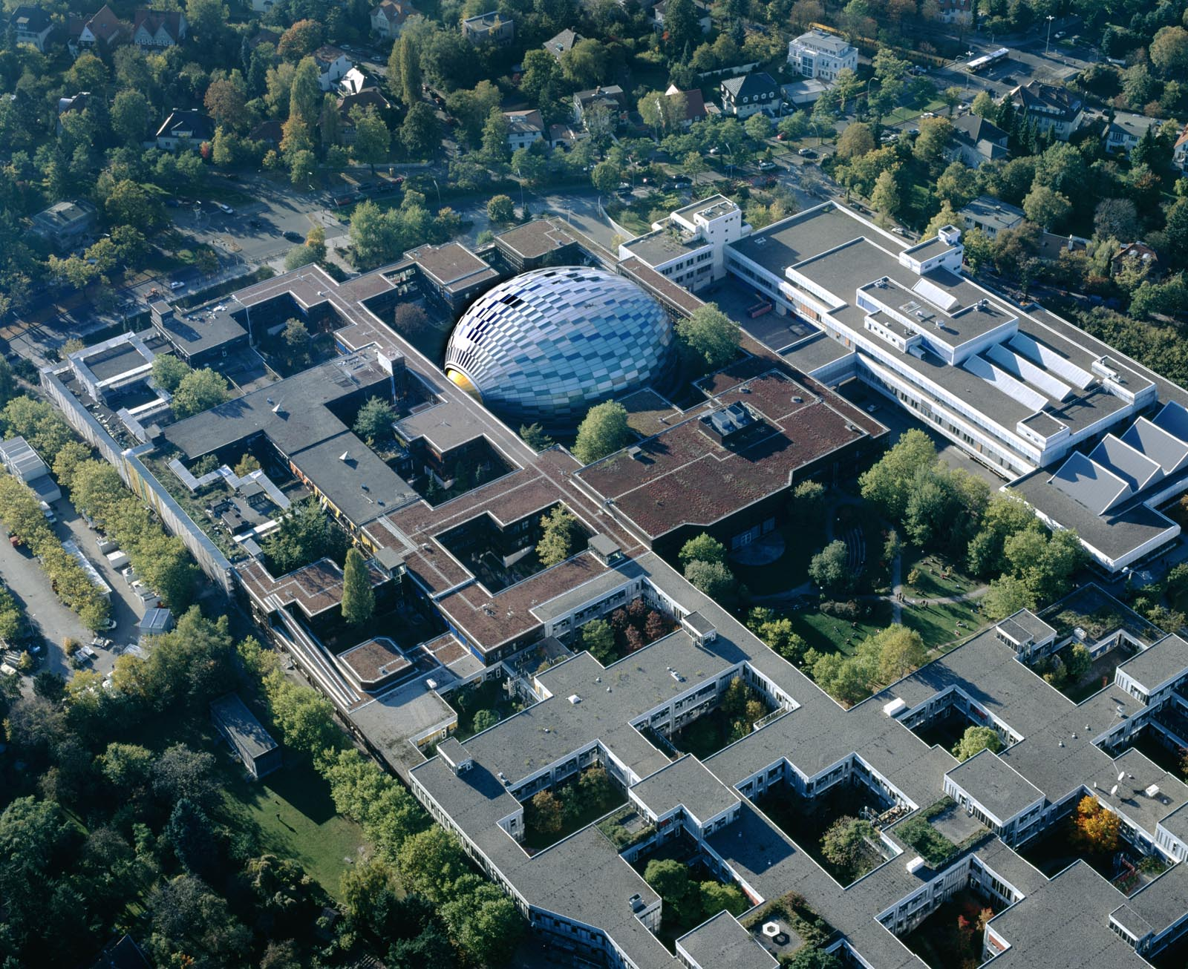
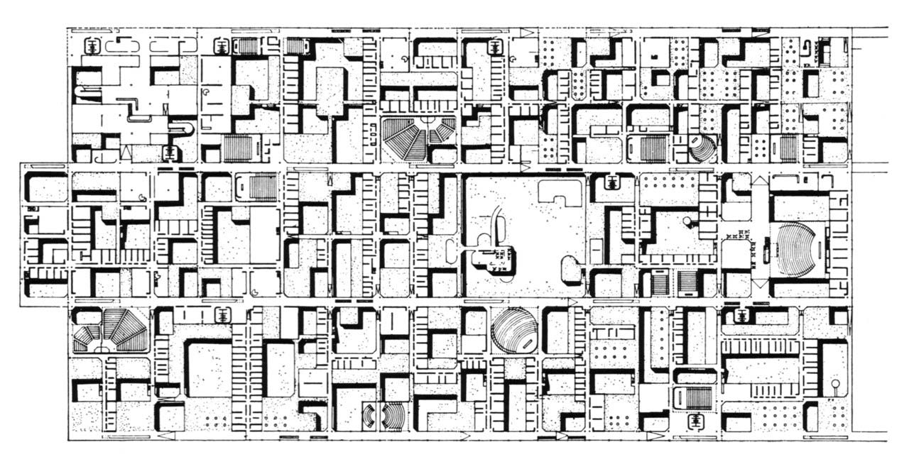
Candilis, Josic, Woods, and Schiedhelm, Berlin Free University, Berlin, Germany (1963)
Notes:
- Another example of a decentralized, bottom-up project that looked principally at organic growth of spaces, rather than strong prescription

Slide 47
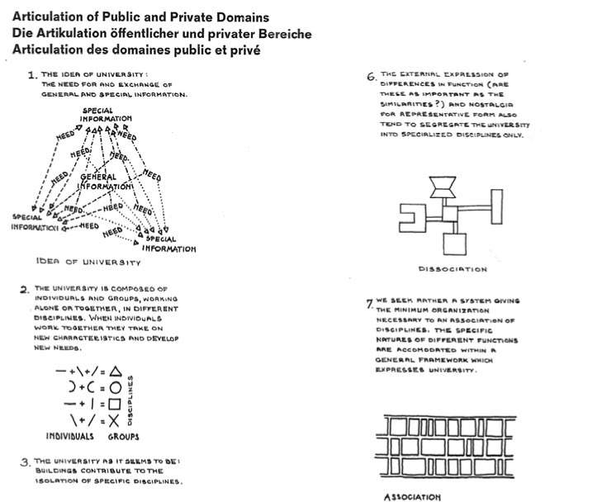
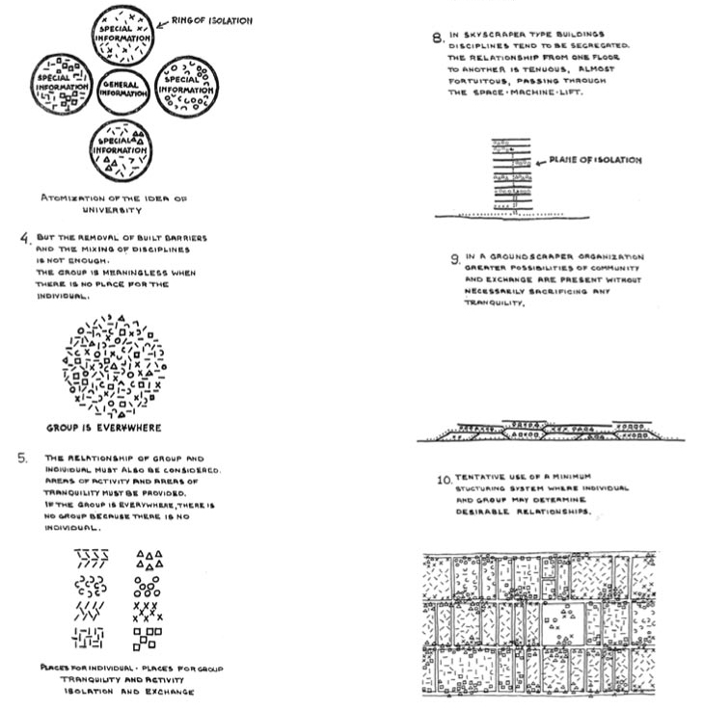
Candilis, Josic, Woods, and Schiedhelm, Berlin Free University, Berlin, Germany (1963)
Notes:
- Originally intended to have no finite limit, as relationship of spaces dictated overall form and extents

Slide 48
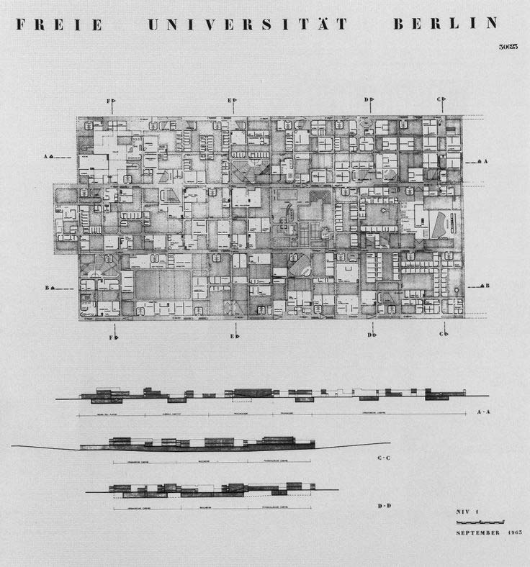
Candilis, Josic, Woods, and Schiedhelm, Berlin Free University, Berlin, Germany (1963)

Slide 49
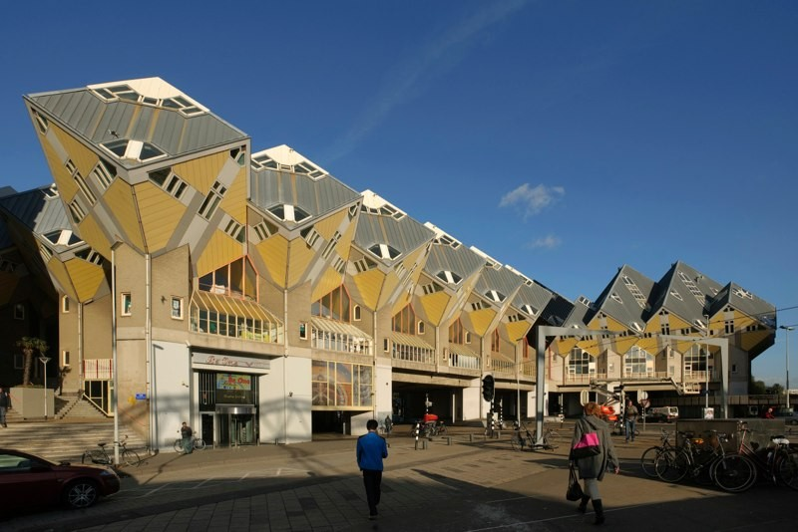
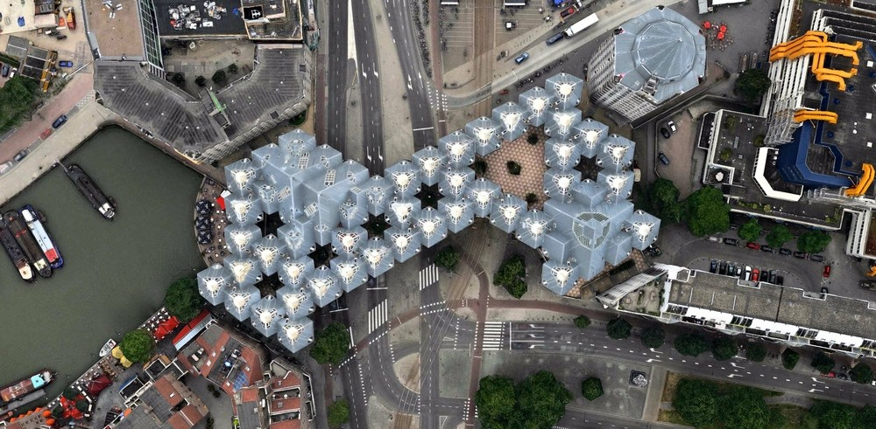
Piet Blom, Kubuswoningen (Cube Houses), Rotterdam, The Netherlands (1977)
Notes:
Piet Blom – Cube Houses (1977)
Clear example of how there was actually an intrinsic link between concept of organic growth and a visual style
Epitomized a period known as ‘Dutch Structuralism’ in particular
Located in a historic section of Rotterdam
Mind you Rotterdam was heavily bombed during WWII, so a lot of reconstruction

Slide 50
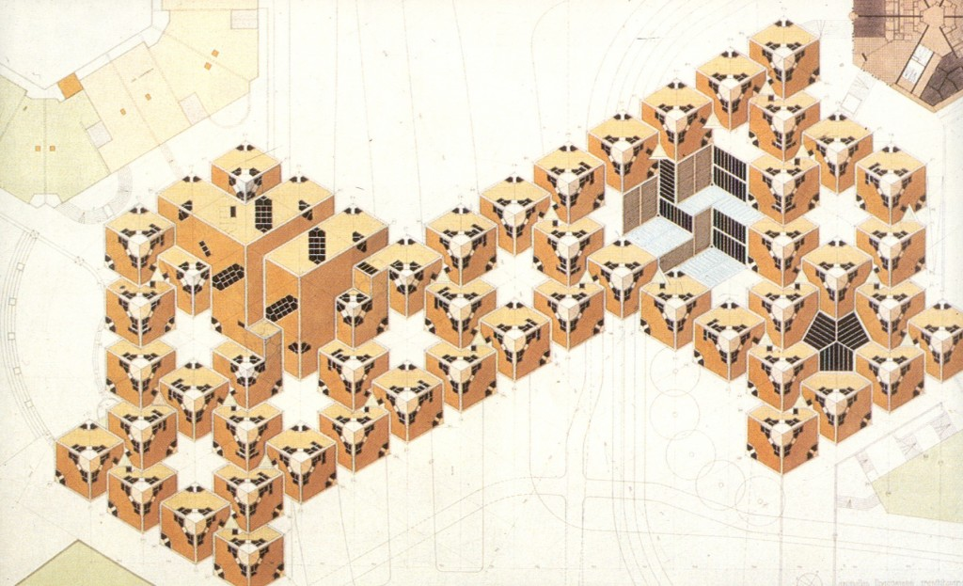
Piet Blom, Kubuswoningen (Cube Houses), Rotterdam, The Netherlands (1977 - 1984)
Notes:
Cube houses composed of about 270 dwellings
Blom felt that urban communities should feel like villages

Slide 51
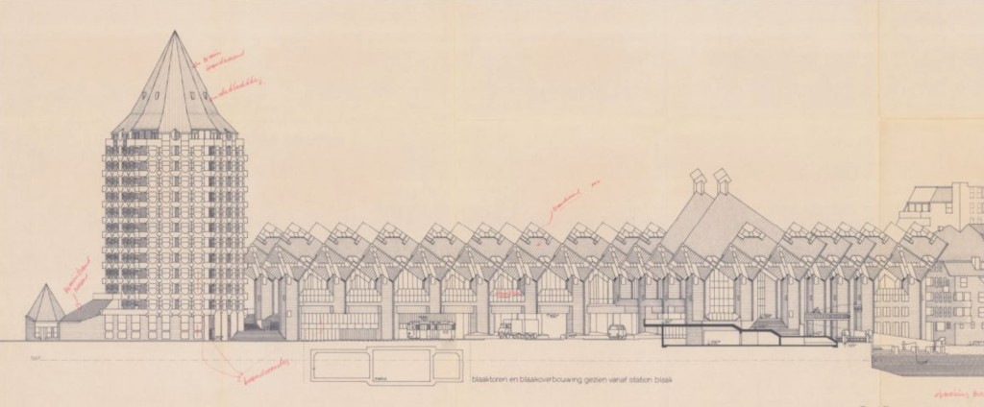
Piet Blom, Kubuswoningen (Cube Houses), Rotterdam, The Netherlands (1977 - 1984)
Notes:
Should be like living in trees
And so the cube houses compose a forest

Slide 52
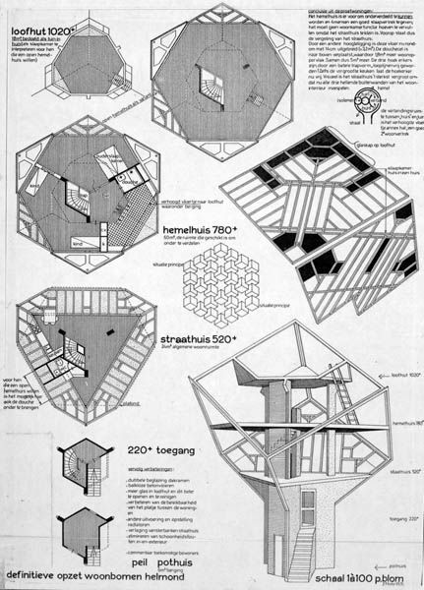
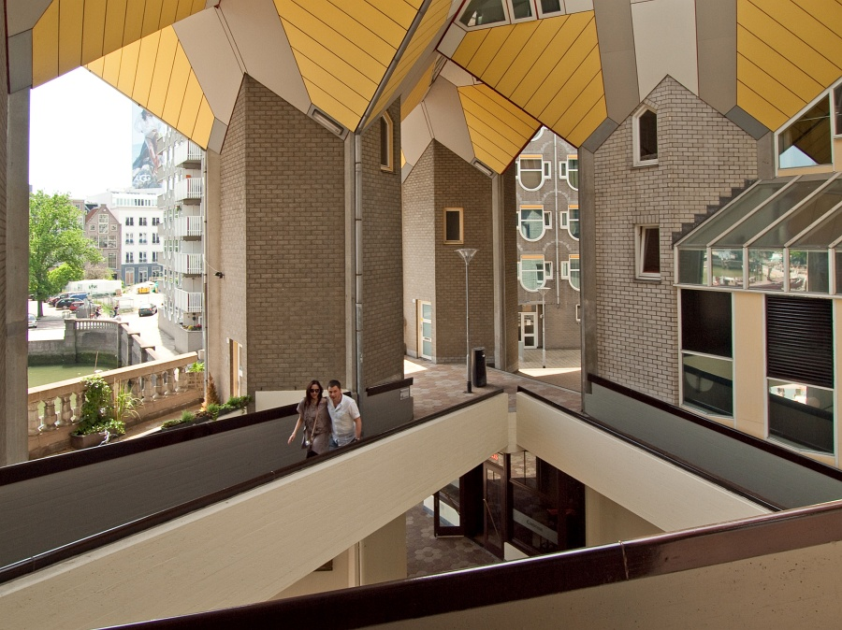
Piet Blom, Kubuswoningen (Cube Houses), Rotterdam, The Netherlands (1977 - 1984)
Notes:
Was actually inspired by the pilotis of Le Corbusier
The trees allowed all infrastructure to pass below
Pedestrian ramps and courtyards were above

Slide 53
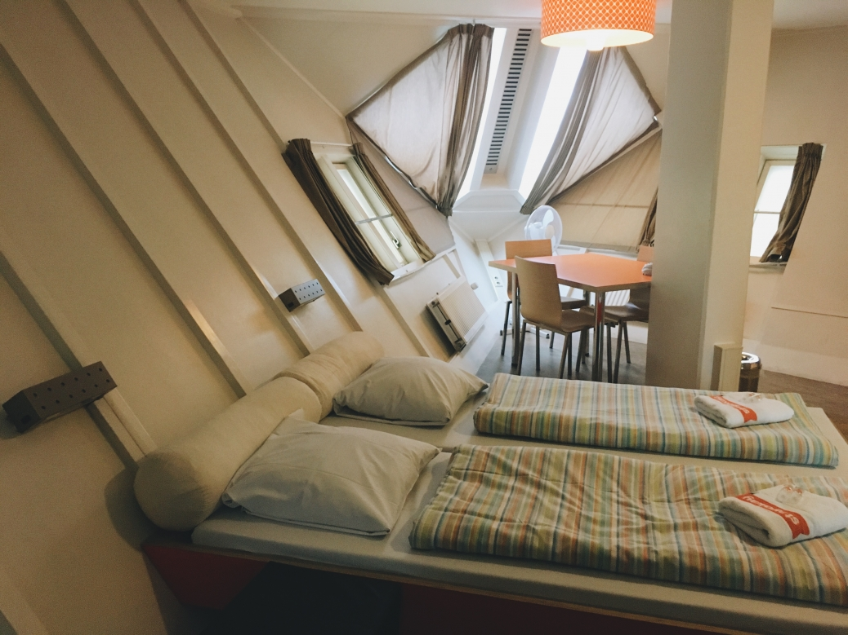
Piet Blom, Kubuswoningen (Cube Houses), Rotterdam, The Netherlands (1977 - 1984)

Slide 54
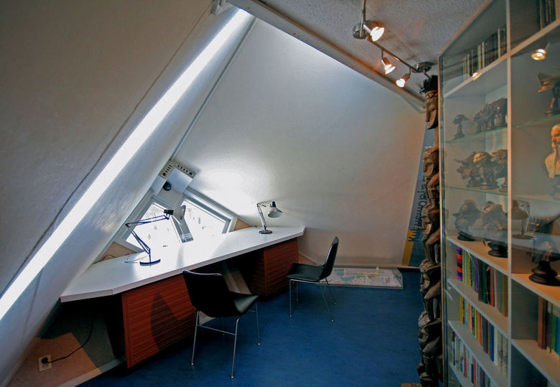
Piet Blom, Kubuswoningen (Cube Houses), Rotterdam, The Netherlands (1977 - 1984)

Slide 55
Piet Blom, studies
Notes:
Interrelationship between drawing, patterns, spatial relationships
No question that patterns were a big part

Slide 56
Jan Verhoeven, studies
Notes:
- Examples beyond those of Piet Blom, from Dutch contemporaries

Slide 57
Joop van Stigt, studies

Slide 58
Left: Herman Hertzberger, spatial relationships
Right: Mathieu Lauweriks, study

Slide 59
Aldo van Eyck, Municipal Orphanage, Amsterdam, The Netherlands (1960)
Right: Vernacular housing of the Dogon tribe of Mali, Africa
Notes:
Aldo van Eyck
Reminder that van Eyck was a founding member of Team X (and so a former member of CIAM)
Criticized Modernism as lack a human element
So wanted the orphanage to engender design principles of a new urban vision
The orphanage was by van Eyck’s account, an explicit small urban study, a prototype
Orphanage in use from 1960 to 1991, now empty
Van Eyck was fascinated by the housing structures of the Dogon people of Mali
Heavily inspired by Structuralism anthropology

Slide 60
Aldo van Eyck, Municipal Orphanage, Amsterdam, The Netherlands (1960)
Notes:
Decentralized pattern of ‘pavilions’
To home 125 children
Continuous volume

Slide 61
Aldo van Eyck, Municipal Orphanage, Amsterdam, The Netherlands (1960)
Notes:
Courtyard serves as the ‘center’ of the building, however the building itself lacks a strict organization, and can be navigated through a number of routes
Each residential units has its own courtyard
As a result, each unit has a direct connection to the outside, as well as an inside street
Concept of connected but cellular
Intentional ambivalence as to interior and exterior, challenging the Modernist formality of house-versus-city
The city a house, the house a city

Slide 62
Aldo van Eyck, Municipal Orphanage, Amsterdam, The Netherlands (1960)
Notes:
Polycentric Structure
Many points of interaction – non-hierarchical

Slide 63
“a house must be like a small city if it’s to be a real house, a city like a large house if it’s to be a real city”
Aldo van Eyck
‘Steps Toward a Configurative Discipline’ (1962)
Aldo van Eyck, Municipal Orphanage, Amsterdam, The Netherlands (1960)

Slide 64
Aldo van Eyck, Municipal Orphanage, Amsterdam, The Netherlands (1960)
Notes:
Ambivalent boundaries defined by void architraves/lintel and waist-level thresholds
Like Hertzberger, not strict, but range of zones between private and public
Within each unit, intimate space, but as a whole, visually boundless

Slide 65
Aldo van Eyck, Municipal Orphanage, Amsterdam, The Netherlands (1960)

Slide 66
Aldo van Eyck, Municipal Orphanage, Amsterdam, The Netherlands (1960)

Slide 67
Aldo van Eyck, Municipal Orphanage, Amsterdam, The Netherlands (1960)

Slide 68
Aldo van Eyck, Municipal Orphanage, Amsterdam, The Netherlands (1960)
Notes:
PLAYGROUNDS
The ideas of the orphanage, I feel, are best illustrated by the van Eyck’s works on playgrounds
Whereby the design of spaces through relationships rather than structures really comes out
Designed hundreds of playgrounds throughout the city of Amsterdam
Only 17 left

Slide 69
Notes:
Van Eyck appointed a designer for the city of Amsterdam public works in 1946
His work aimed at creating places that fostered dialog, interaction – relations (structures) that create community
Exploited spatial ambiguities, especially since the playgrounds were often relegated to infill spaces
Not strict programming of spaces
Kids have to come up with the rules of play by taking cues from the built environment
Intentional ‘misuse’ of things (bars, walls, benches) to recreate, reassign value to the architectural work

Slide 70
Aldo van Eyck, Municipal Orphanage, Amsterdam, The Netherlands (1960)
Notes:
Also pedagogical role – stimulating creativity in children
But also community ownership of spaces
‘The city as a playground’

Slide 71
Aldo van Eyck, Municipal Orphanage, Amsterdam, The Netherlands (1960)

Slide 72
METABOLISM
Notes:
Can’t say that Metabolism grew as a direct outgrowth of TeamX and the movements that were inspired by the larger Structuralism, nevertheless, many of their projects were concurrent, and shared similar if not the same interests
Predominantly and most known for its place in Japanese Mid-century architecture

Slide 73
Tokyo, c. 1960
Arato Isozaki, Clusters in the Air (1962)
Notes:
The modern city could be made into a dynamic machine of moving and variable parts.

Slide 74
Source: Bureau of General Affairs, TMG
Tokyo, c. 1960
Notes:
Why this dynamicism? 2 Reasons
Reconception of the city after Modernism
Boom in Japanese population

Slide 75
Kisho Kurokawa, Floating City (1961)
Arato Isozaki, Join Core System (1960)
Notes:
Expansion (1)
Kit of parts structures
Minimum living units (2)
You’ll always see a dynamic b/w fixed and changeable, ‘structure’ and ‘add-on’

Slide 76
Arato Isozaki, Join Core System (1960)
Kisho Kurokawa, Helix City (1961)

Slide 77
BIODYNAMICISM
Notes:
‘BIODYNAMICISM’
top-down to bottom-up
A kind of engineered spontaneity

Slide 78
“We regard human society as a vital process – a continuous development from atom to nebula. The reason why we use such a biological word, metabolism, is that we believe design and technology should be a denotation of human vitality.”
Noboru Kawazoe

Slide 79
Kisho Kurokawa
Japanese, 1934 - 2007
Kenzo Tange
Japanese, 1913 - 2005
Fumihiko Maki
Japanese, 1928 - Present
Notes:
Have to remember that these were young architects that had just lived through WWII, and they were eager to find building solutions that could respond to a rapidly changing and technologically advancing Japan
Likewise, they were excited about groups like CIAM, and their rejection of Modernist determinism
However, they felt that many of their European counterparts were not embracing new technologies enough, incorporating them into a theory of city-building

Slide 80
Kisho Kurokawa
Japanese, 1934 - 2007
Kenzo Tange
Japanese, 1913 - 2005
Fumihiko Maki
Japanese, 1928 - Present
Notes:
Tange – ‘elder’
Would involve himself with ‘Metabolism’ for only a short period, as very soon, he believed their fascination for technology was verging on the fetishistic – an obsession with technology for its own sake, without incorporating enough the tradition of architecture

Slide 81
Kisho Kurokawa
Japanese, 1934 - 2007
Kenzo Tange
Japanese, 1913 - 2005
Fumihiko Maki
Japanese, 1928 - Present
Notes:
Maki – ‘theorist’, though he did build
Significant experience in the West, particularly with Washington University in STL
He developed an important theoretical overview that enable Metabolist thought

Slide 82
Kisho Kurokawa
Japanese, 1934 - 2007
Kenzo Tange
Japanese, 1913 - 2005
Fumihiko Maki
Japanese, 1928 - Present
Notes:
Kurowaka, unapologetically Metabolist, all in attitude

Slide 83
Kisho Kurokawa, Nakagin Capsule Tower, Tokyo (1972)
Notes:
Kisho Kurokawa
Nagakin Capsule Tower (1972)
Kurokawa interested in shift from ‘mechanical’ to ‘biodynamic age’
Ecology
ambivalent intermediate zones
cycles of life
Intention to addressing an emerging demographic in Japan
Traveling businessperson
To provide the minimum temporary dwelling unit

Slide 84
Kisho Kurokawa, Nakagin Capsule Tower, Tokyo (1972)
Notes:
Plugging in was central (only 4 bolts holds each capsule)
Construction could be ongoing
Maintenance may require unplugging/replugging
No defined physical limit

Slide 85
Kisho Kurokawa, Nakagin Capsule Tower, Tokyo (1972)
Notes:
140 total capsules
Still standing today
Stacked and rotating at various angles

Slide 86
Kisho Kurokawa, Nakagin Capsule Tower, Tokyo (1972)

Slide 87
Kisho Kurokawa, Nakagin Capsule Tower, Tokyo (1972)

Slide 88
Poster from 1929 CIAM Conference: Existenzminimum
Kisho Kurokawa, Nakagin Capsule Tower, Tokyo (1972)
Notes:
Intended to be fully integrative of all regular living duties
Recalls CIAM ‘Existenzminimum’
We see in movies the legacy of Kurokawa’s Metabolism
The aesthetic very much of contemporary science fiction culture

Slide 89
Source: Bureau of General Affairs, TMG
Kenzo Tange, Tokyo Bay Masterplan, Tokyo (1960)
Notes:
Kenzo Tange
Again, Tange wasn’t so within the core of Metabolism as Kurokawa, but was nevertheless a pivot figure in the its initial development and support
More about Tokyo Bay (1960) than Tange’s general oeuvre
From 3.5 million in 1945 to 9.5 million in 1960

Slide 90
“every time a fine new building is erected in the metropolitan center, the city moves one step closer to a comatose state… the permanent structure of the modern metropolis is incompatible with the movement that is necessary to the life of the metropolis. The old body can no longer contain the new life.”
Kenzo Tange (1961)
Kenzo Tange, Tokyo Bay Masterplan, Tokyo (1960)

Slide 91
Kenzo Tange, Tokyo Bay Masterplan, Tokyo (1960)
Notes:
During this population boom, most were looking away from Tokyo for further development, but Tange propose Tokyo Bay for ‘internal expansion’
Together with other architects, Tange Lab (University of Tokyo):
Arata Isozaki
Kisho Kurokawa

Slide 92
Kenzo Tange, Tokyo Bay Masterplan, Tokyo (1960)
Notes:
Heavily infrastructural (permanent)
Residence (temporary)
Looping highways form vertebrae across the sea

Slide 93
Kenzo Tange, Tokyo Bay Masterplan, Tokyo (1960)
Notes:
Projection for 5 million residents
Working units along the vertebrae (on roads)
Future-looking, postindustrial
No manufacturing, just offices, technology, information, communications

Slide 94
Kenzo Tange, Tokyo Bay Masterplan, Tokyo (1960)

Slide 95
Fumihiko Maki, ‘Group Form’
Notes:
Fumihiko Maki
Unlike Kurokawa or Tange, Maki’s work was far more theoretical (though he’d build much more later on in his career)
Central contribution to this discussion was the idea of Group Form/Collective Form
‘Investigations in Collective Form’ (1964)
He came up with this theory as a means to make sense of an increasing heterogeneity of urban planning
Rather than saying ‘this good and that bad’, his approach was to acknowledge the complexity inherent in building and society
And so summarized the predominant types of Collective Form

Slide 96
‘Compositional Form’
Left: Rockefeller Center, NYC. Right: Illinois Institute of Technology, Chicago.
Notes:
COMPOSITIONAL FORM
Heavily favored by the pervious Modernists

Slide 97
‘Compositional Form’
Forbidden City, Beijing
Notes:
COMPOSITIONAL FORM
Like the design of buildings, but only larger
Think of it like a composition: a little added here, a little added there, to achieve an idea of a ‘total work’
Static, because forming a composition traditionally means arriving at a ‘perfect’ end state
Discreet units are compositionally assembled together to feed off of each other

Slide 98
‘Megaform’
Left: Kenzo Tange, Tokyo Bay Masterplan, Tokyo. Right: Le Corbusier, Algiers Masterplan, Algiers.
Notes:
MEGASTRUCTURE/MEGAFORM
Heavily favored by Brutalists

Slide 99
‘Megaform’
Paul Rudolph, Lower Manhattan Expressway, NYC (1972)
Notes:
MEGAFORM / MEGASTRUCTURE
Often heavily infrastructural
The building becomes so large, it becomes unclear as to if it should be considered a building or a development
Although the basic blueprint is often static, it is fundamentally susceptible to adaptation
So the masterplan is indicative rather than finalized (contrary to Compositional Form)

Slide 100
‘Group Form’
Left: Santorini, Greece. Jeonju Village, South Korea
Notes:
GROUP FORM/COLLECTIVE FORM
Heavily favored by Team X and Metabolists

Slide 101
‘Group Form’
Dogon settlement, Mali
Notes:
GROUP FORM / COLLECTIVE FORM
Unlike the previous two, form is ‘generated’ rather than composed
Epitome of ‘bottom-up’ organization
Clearly shared interests with members of Team X, especially Aldo van Eyck
Often dependent on geographic and contextual constraints
Often about smaller units, multiplied
Bottom up design, no ‘masterplan’ per se
Traditional villages as paradigm
Embedded with the building unit are potentials for linkages to other units, as well as shared structures (e.g. infrastructure)
Described it as a universal condition (pan-cultural, pan-historical)
Conclusion to three types
Usually not just one or the other, but hybrid conditions

Slide 102
Kisho Kurokawa, Agricultural City (1960)

Slide 103
Kenzo Tange, Tokyo Bay Masterplan, Tokyo (1960)

Slide 104
Yoji Watanabe, New Sky Building #3 (1972)

Slide 105
Kiyonori Kikutake, Ocean City (1968)

Slide 106
Kiyonori Kikutake, Hotel Tokoen, Gunma (1964)

